Slide 1
Polynomials and The Fast Fourier Transform (FFT)

Slide 2

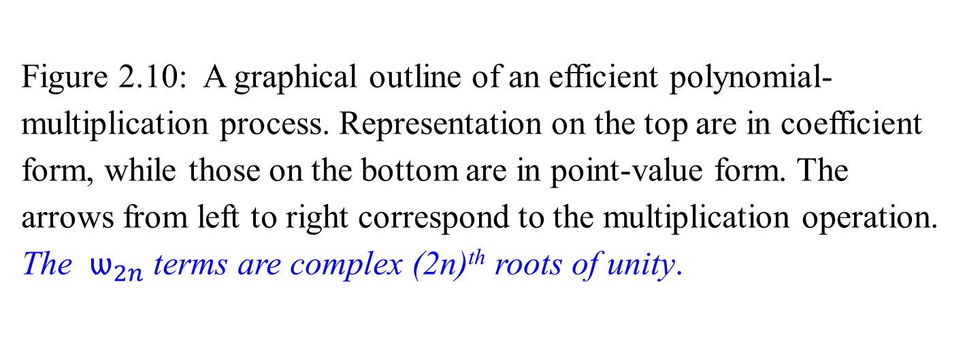
Fast multiplication
of polynomials in coefficient form
Figure 2.10: A graphical outline of an efficient polynomial-multiplication process. Representation on the top are in coefficient form, while those on the bottom are in point-value form. The arrows from left to right correspond to the multiplication operation. The $ѡ_{2n}$terms are complex (2n)^{th} roots of unity.
FFT
2n points around a unit circle.

Slide 3
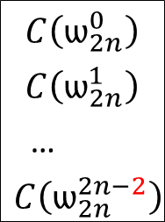
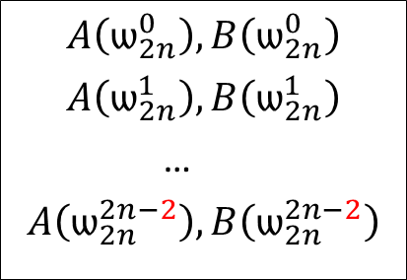
Comment: for x³, If n-1=3, then n=4 terms for x⁶, if 2n-2=6, then 2n-1=7 terms. a₃ x³ * b₃ x³ = a₃ b₃ x⁶.
a₀ , a₁, …, a_{n-1}
b₀ , b₁, …, b_{n-1}
Ordinary
Multiplication
Time Θ(n²)
convolution
c₀ , c₁, …, c_{2n-2}
Coefficient
representation
FFT
Evaluation Interpolation
Time Θ(n log n) Time Θ(n log n)
$$A\left(ѡ_{2n}^{0}\right), B\left(ѡ_{2n}^{0}\right)$$
$$A\left(ѡ_{2n}^{1}\right), B\left(ѡ_{2n}^{1}\right)$$
…
$$A\left(ѡ_{2n}^{2n−2}\right), B\left(ѡ_{2n}^{2n−2}\right)$$
$$C\left(ѡ_{2n}^{0}\right)$$
$$C\left(ѡ_{2n}^{1}\right)$$
…
$$C\left(ѡ_{2n}^{2n−2}\right)$$
Pointwise multiplication
Point-value
multiplication
Time Θ(n)
Figure 2.10:
The $ѡ_{2n}$terms are complex (2n)^{th} roots of unity.

Slide 4
Polynomials and The Fast Fourier Transform (FFT)
Use any points as evaluation points.
Choose “complex roots of unit” as the evaluation points;
apply the discrete Fourier transform (DFT) of a coefficient vector to produce a point-value representation of a coefficient vector.
Allow to convert between representations in only Θ(n log n) time.
For the interpolation process,
perform the inverse operation by taking the “inverse DFT” of point-value pairs to yield a coefficient vector.
Use the FFT accomplishes the DFT and inverse DFT operations in Θ(n log n) time.

Slide 5

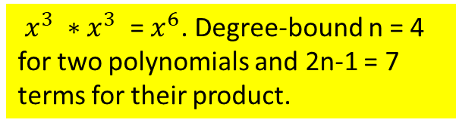
Polynomials and The Fast Fourier Transform (FFT)
$x^{3} ∗x^{3}$ = $x^{6}$. Degree-bound n = 4 for two polynomials and 2n-1 = 7 terms for their product.
A concern is degree-bounds - Figure 2.10 shows the strategy graphically.
Given polynomials
A(x) = a₀ + a₁x¹ + … + a_{n-1}x^{n-1} of degree-bound n (of degree n-1)
B(x) = b₀ + b₁x¹ + … + b_{n-1}x^{n-1} of degree-bound n (of degree n-1),
the product, C(x) = A(x) * B(x) is a polynomial
C(x) = c₀ + c₁x¹ + … + c_{n-1}x^{n-1} + c_{n}x^{n} + c_{n+1}x^{n+1} + … + c_{2n-2}x^{2n-2} ) of degree-bound 2n-1 (of degree 2n -2).
Evaluating the input polynomials A and B,
first double their degree-bounds to 2n-1 by adding n-1 number of high-order coefficients of 0. e.g.,
a₀ + a₁x¹ + … + a_{n-1}x^{n-1} + 0_{n}x^{n} + 0_{n+1}x^{n+1} + … + 0_{2n-2}x^{2n-2} , or
a₀, a₁, …, a_{n-1}, 0_{n}, 0_{n+1}, …, 0_{2n-2}.
Because the vectors have 2n-1 elements, we use “complex (2n)^{th} roots of unity,” which are denoted by the $ѡ_{2n}$terms.

Slide 6
Polynomials and The Fast Fourier Transform (FFT)
Instead, we check the obtained point-value pairs by computing A(x) * B(x):
6x³ + 7x² - 10x + 9 …A(x)
- 2x³ + 4x - 5 …B(x)
- 30x³ - 35x² + 50x - 45
- 24x⁴ - 28x³ + 40x² - 36x
- 12x⁶ - 14x⁵ + 20x⁴ - 18x³ .
- 12x⁶ - 14x⁵ + 44x⁴ - 20x³ - 75x² + 86x - 45 …C(x)
The degree-bound of A(x) and B(x) is n = 4. That is there is 4 terms for each expression.
Then the degree-bound of C(x) is 2n -1 = 7. That is there is 7 terms for C(x).
Then the coefficient representation for A(x) has to be set as ( 9, -10, 7, 6, 0, 0, 0),
and the coefficient representation for B(x) has to be set as (-5, 4, 0, -2, 0, 0, 0).
The coefficient representation for C(x) = A(x) * B(x) is (-45, 86, -75, -20, 44, -14, -12).

Slide 7
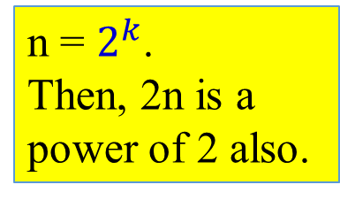
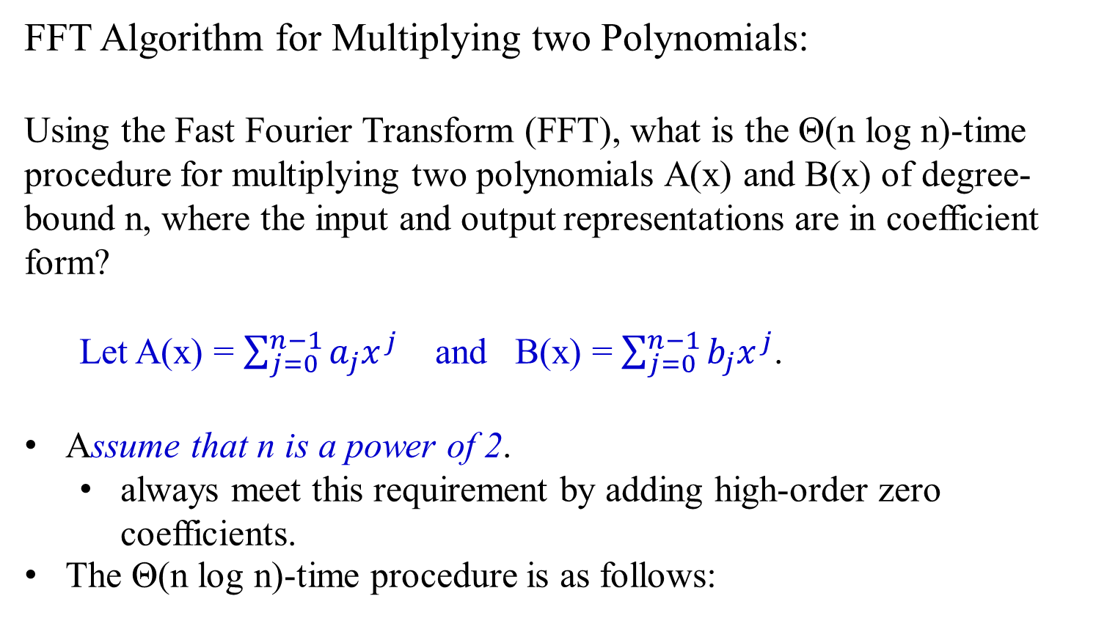
Polynomials and The Fast Fourier Transform (FFT)
FFT Algorithm for Multiplying two Polynomials:
Using the Fast Fourier Transform (FFT), what is the Θ(n log n)-time procedure for multiplying two polynomials A(x) and B(x) of degree-bound n, where the input and output representations are in coefficient form?
Let A(x) = $\sum_{j=0}^{n−1}{a_{j}x^{j}}$ and B(x) = $\sum_{j=0}^{n−1}{b_{j}x^{j}}$.
Assume that n is a power of 2.
always meet this requirement by adding high-order zero coefficients.
The Θ(n log n)-time procedure is as follows:
n = $2^{k}$.
Then, 2n is a power of 2 also.

Slide 8
The Θ(n log n)-time procedure is as follows:
Let polynomials be
A(x) = a₀ + a₁x¹ + … + a_{n-1}x^{n-1} of degree-bound n (of degree n-1)
B(x) = b₀ + b₁x¹ + … + b_{n-1}x^{n-1} of degree-bound n (of degree n-1),
Double degree-bound: Create coefficient representations of A(x) and B(x) as degree-bound 2n-1 polynomials by adding n - 1 high-order zero coefficients to each. e.g.,
a₀, a₁, …, a_{n-1}, 0_{n}, 0_{n+1}, …, 0_{2n-2}.
b₀, b₁, …, b_{n-1}, 0_{n}, 0_{n+1}, …, 0_{2n-2}.
This takes Θ(n).
2. Evaluate: Compute point-value representation of A(x) and B(x) of length 2n-1 by applying the FFT of order 2n-2 on each polynomial. These representations contain the values of the two polynomials at the (2n)^{th} roots of unity.
This takes time Θ(n log n).
3. …

Slide 9
3. Pointwise multiply: Compute a point-value representation for the polynomial C(x) = A(x)*B(x) by multiplying these point-values of A(x) and B(x) together pointwise. This representation contains the value of C(x) at each (2n)^{th} root of unity. This takes Θ(n).
4. Interpolate: Create the coefficient representation of the polynomial C(x) by applying the FFT on 2n -1 point-value pairs to compute the inverse DFT.
This take time Θ(n log n).
Step (1) and (3) take time Θ(n), and step (2) and (4) take time Θ(n log n).
Theorem 2.5
Time efficiency for multiply two polynomials of degree-bound n is Θ(n log n), with both the input and output representation in coefficient form.
we show how to use the FFT.

Slide 10
The DFT and FFT
Claimed that if we use complex roots of unity, we can evaluate and interpolate polynomials in Θ(n log n) time.
In the following,
define complex roots of unity and their properties,
define the DFT and then
show how the FFT computes the DFT and
its inverse in Θ(n log n) time.

Slide 11
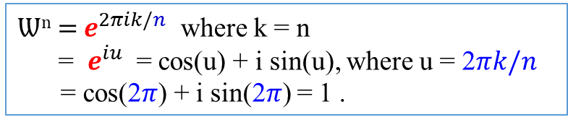
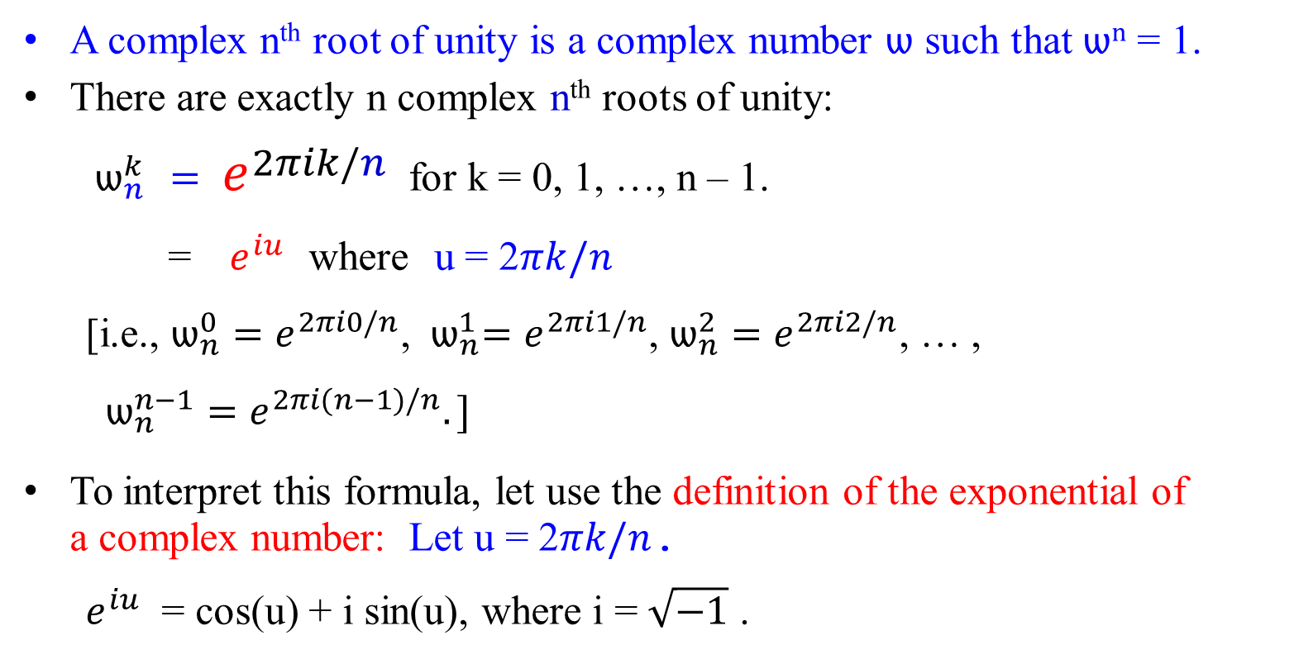

Ѡ^{n} = $e^{2πik/n}$ where k = n
= $e^{iu}$ = cos(u) + i sin(u), where u = 2$πk/n$
= cos(2$π$) + i sin(2$π$) = 1 .
Complex roots of unity
A complex n^{th} root of unity is a complex number ѡ such that ѡ^{n} = 1.
There are exactly n complex n^{th} roots of unity:
${ ѡ}_{n}^{k}$ $= e^{2πik/n}$ for k = 0, 1, …, n – 1.
= ${ e}^{iu}$ where u = 2$πk/n$
[i.e., ${ѡ_{n}^{0}=e}^{2πi0/n}$, ${{ ѡ}_{n}^{1}=e}^{2πi1/n}$, ${ѡ_{n}^{2}=e}^{2πi2/n}$, … , $ѡ_{n}^{n−1}=e^{2πi(n−1)/n}.]$
To interpret this formula, let use the definition of the exponential of a complex number: Let u = 2$πk/n$.
$e^{iu}$ = cos(u) + i sin(u), where i = $\sqrt{−1}$ .
Let n = 8. For k = 0, 1, 2, 3, …
u = 2$π0/8$ = 0, 2$\frac{π1}{8}=\frac{π}{\text{4,}}$ 2$\frac{π2}{8}=\text{ =}\frac{π}{\text{2}\text{,}}\text{, }$ 2$\frac{π3}{8}=\text{ =}\frac{3π}{\text{4}\text{,}}\text{, }$… , 2$\frac{π7}{8}=\frac{7π}{\text{4,}}$ , then next will be 2$\frac{π8}{8}=\text{2}π$….

Slide 12
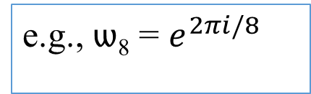

Complex roots of unity
Figure 2.11 shows that the n complex roots of unity are equally spaced around the circle of unit radius centered at the origin of the complex plane.
The value
ѡ_{n} = $e^{2πi/n}$ ……………… (2.18)
is the principal n^{th} root of unity;
all other complex nth roots of unity are powers of ѡ_{n}.
e.g., ѡ₈ = $e^{2πi/8}$

Slide 13
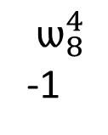
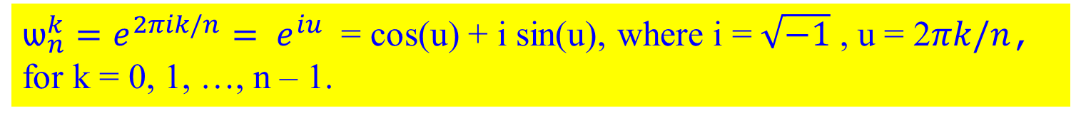


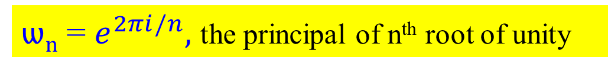
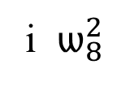
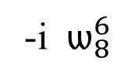
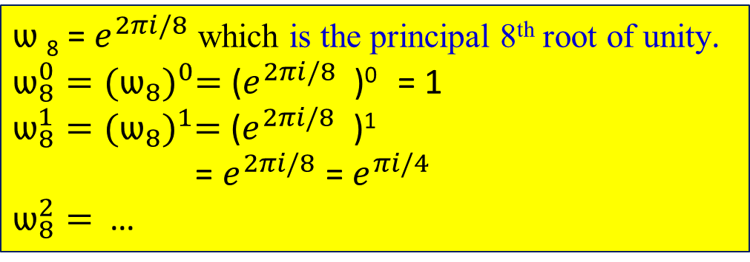

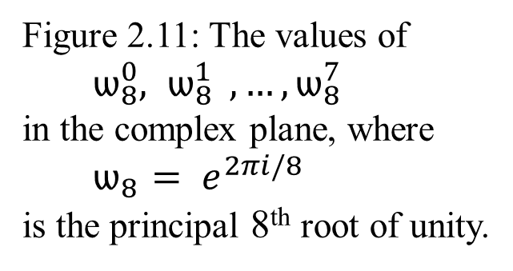
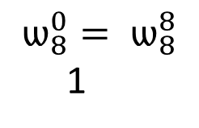

ѡ_{n} = $e^{2πi/n},$ the principal of n^{th} root of unity
${ѡ_{n}^{k}=e^{2πik/n}= e}^{iu}$ = cos(u) + i sin(u), where i = $\sqrt{−1}$ , u = 2$πk/n$, for k = 0, 1, …, n – 1.
i $ѡ_{8}^{2}$
$ѡ_{8}^{3}$
$$ѡ_{8}^{1}$$
Figure 2.11: The values of ${ ѡ}_{8}^{0}{, ѡ}_{8}^{1} , …, ѡ_{8}^{7}$ in the complex plane, where ${ ѡ}_{8 }{= e}^{2πi/8}$ is the principal 8th root of unity.
$$ѡ_{8}^{4}$$
-1
$$ѡ_{8}^{0}= ѡ_{8}^{8}$$
1
$ѡ$₈ = $e^{2πi/8}$ which is the principal 8th root of unity.
$ѡ_{8}^{0}={(ѡ_{8})}^{0}=$($e^{2πi/8}$ )⁰ = 1
$ѡ_{8}^{1}={(ѡ_{8})}^{1}=$($e^{2πi/8}$ )¹
= $e^{2πi/8}$ = $e^{πi/4}$
$ѡ_{8}^{2}=$ …
$${ ѡ}_{8}^{5}$$
$$ѡ_{8}^{7}$$
-i $ѡ_{8}^{6}$

Slide 14


Example 2.26: Analysis of the complex n^{th} root of unity
$ѡ_{8}^{0}={(ѡ_{8})}^{0}=$($e^{2πi/8}$ )⁰ = 1, for k = 0.
${ѡ_{n}^{k}=e^{2πik/n}= e}^{iu}$ = cos(u) + i sin(u), where
i = $\sqrt{−1}$ , u = 2$πk/n$, for k = 0, 1, …, n – 1.
$ѡ_{8}^{1}$ = $e^{i2πk/8}$ = $e^{i2π/8}$
= cos($\frac{2π}{8}$) + i sin($\frac{2π}{8}$), where i = $\sqrt{−1}$
= cos($\frac{π}{4}$) + i sin($\frac{π}{4}$),
= $\frac{1}{\sqrt{2}} +i \frac{1}{\sqrt{2}}$ = $\frac{1}{\sqrt{2}}$(1 + i) $={(ѡ_{8})}^{1}$ = $ѡ_{8}^{1}$
cos 0 = 1 sin 0 = 0
cos $\frac{π}{4}$ = $\frac{1}{\sqrt{2}}$ sin $\frac{π}{4}$ = $\frac{1}{\sqrt{2}}$
cos $\frac{π}{2}$ = 0 sin $\frac{π}{2}$ = 1
cos $\frac{3π}{4}$ =- $\frac{1}{\sqrt{2}}$ sin $\frac{3π}{4}$ = $\frac{1}{\sqrt{2}}$
cos π = -1 sin π = 0
cos $\frac{5π}{4}$ =- $\frac{1}{\sqrt{2}}$ sin $\frac{5π}{4}$ = - $\frac{1}{\sqrt{2}}$
cos $\frac{3π}{2}$ = 0 sin $\frac{3π}{2}$ = -1
cos $\frac{7π}{4}$ = $\frac{1}{\sqrt{2}}$ sin $\frac{7π}{4}$ = - $\frac{1}{\sqrt{2}}$
cos 2π = 1 sin 2π = 0

Slide 15
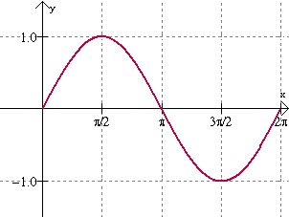
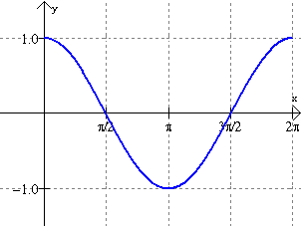

Slide 16

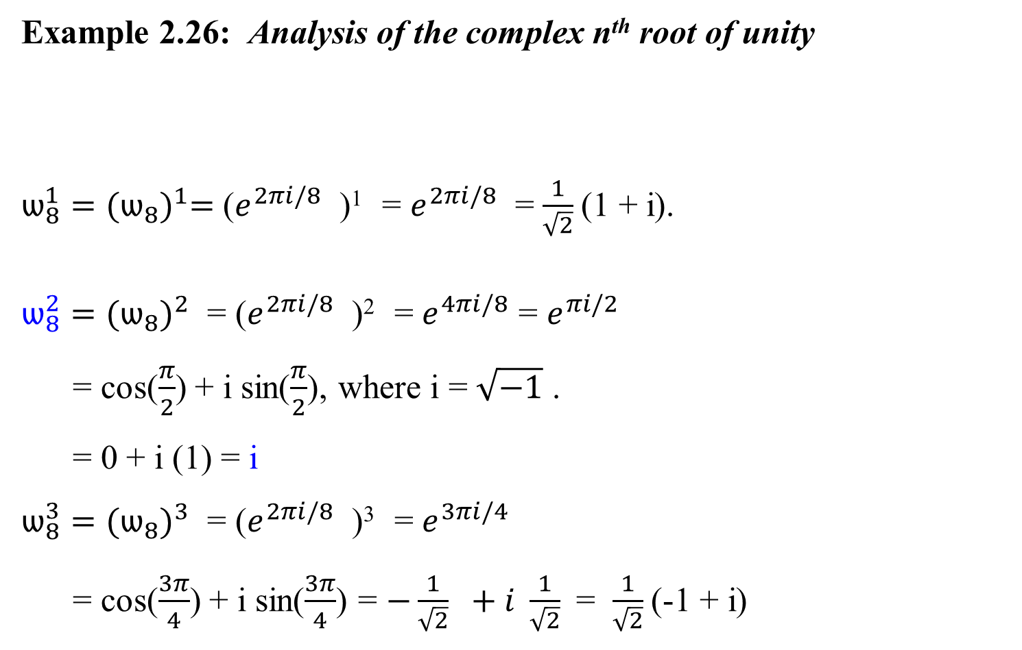
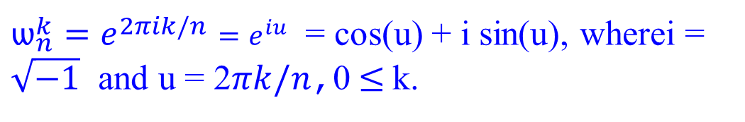
Example 2.26: Analysis of the complex n^{th} root of unity
$ѡ_{8}^{1}={(ѡ_{8})}^{1}=$($e^{2πi/8}$ )¹ = $e^{2πi/8}$ = $\frac{1}{\sqrt{2}}$(1 + i).
$ѡ_{8}^{2}={(ѡ_{8})}^{2}$ = ($e^{2πi/8}$ )² = $e^{4πi/8}$ = $e^{πi/2}$
= cos($\frac{π}{2}$) + i sin($\frac{π}{2}$), where i = $\sqrt{−1}$ .
= 0 + i (1) = i
$ѡ_{8}^{3}={(ѡ_{8})}^{3}$ = ($e^{2πi/8}$ )³ = $e^{3πi/4}$
= cos($\frac{3π}{4}$) + i sin($\frac{3π}{4}$) = $−\frac{1}{\sqrt{2}} +i \frac{1}{\sqrt{2}}$ = $\frac{1}{\sqrt{2}}$(-1 + i)
${ѡ_{n}^{k}=e^{2πik/n}=e}^{iu}$ = cos(u) + i sin(u), wherei = $\sqrt{−1}$ and u = 2$πk/n$,0$≤$k.
cos 0 = 1 sin 0 = 0
cos $\frac{π}{4}$ = $\frac{1}{\sqrt{2}}$ sin $\frac{π}{4}$ = $\frac{1}{\sqrt{2}}$
cos $\frac{π}{2}$ = 0 sin $\frac{π}{2}$ = 1
cos $\frac{3π}{4}$ =- $\frac{1}{\sqrt{2}}$ sin $\frac{3π}{4}$ = $\frac{1}{\sqrt{2}}$
cos π = -1 sin π = 0
cos $\frac{5π}{4}$ =- $\frac{1}{\sqrt{2}}$ sin $\frac{5π}{4}$ = - $\frac{1}{\sqrt{2}}$
cos $\frac{3π}{2}$ = 0 sin $\frac{3π}{2}$ = -1
cos $\frac{7π}{4}$ = $\frac{1}{\sqrt{2}}$ sin $\frac{7π}{4}$ = - $\frac{1}{\sqrt{2}}$
cos 2π = 1 sin 2π = 0

Slide 17


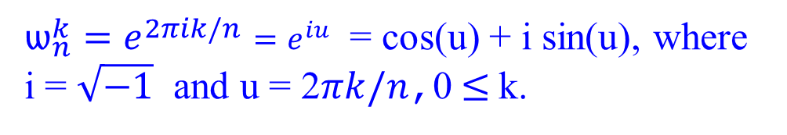

Example 2.26: Analysis of the complex n^{th} root of unity
$ѡ_{8}^{4}={(ѡ_{8})}^{4}$ = ($e^{2πi/8}$ )⁴ = $e^{8πi/8}$
= $e^{πi}$ = cos (π) + i sin (π), where i = $\sqrt{−1}$ .
= -1 + i (0) = -1
$ѡ_{8}^{5}={(ѡ_{8})}^{5}=$($e^{2πi/8}$ )⁵ = $e^{5πi/4}$
= cos($\frac{5π}{4}$) + i sin($\frac{5π}{4}$) = $−\frac{1}{\sqrt{2}} −i \frac{1}{\sqrt{2}}$ = $\frac{1}{\sqrt{2}}$(-1 - i)
$ѡ_{8}^{6}={(ѡ_{8})}^{6}$ = ($e^{2πi/8}$ )⁶ = $e^{12πi/8}$
= $e^{3πi/2}$ = cos($\frac{3π}{2}$) + i sin($\frac{3π}{2}$), where i = $\sqrt{−1}$ .
= 0 + i (-1) = - i
${ѡ_{n}^{k}=e^{2πik/n}=e}^{iu}$ = cos(u) + i sin(u), where
i = $\sqrt{−1}$ and u = 2$πk/n$,0$≤$k.
cos 0 = 1 sin 0 = 0
cos $\frac{π}{4}$ = $\frac{1}{\sqrt{2}}$ sin $\frac{π}{4}$ = $\frac{1}{\sqrt{2}}$
cos $\frac{π}{2}$ = 0 sin $\frac{π}{2}$ = 1
cos $\frac{3π}{4}$ =- $\frac{1}{\sqrt{2}}$ sin $\frac{3π}{4}$ = $\frac{1}{\sqrt{2}}$
cos π = -1 sin π = 0
cos $\frac{5π}{4}$ =- $\frac{1}{\sqrt{2}}$ sin $\frac{5π}{4}$ = - $\frac{1}{\sqrt{2}}$
cos $\frac{3π}{2}$ = 0 sin $\frac{3π}{2}$ = -1
cos $\frac{7π}{4}$ = $\frac{1}{\sqrt{2}}$ sin $\frac{7π}{4}$ = - $\frac{1}{\sqrt{2}}$
cos 2π = 1 sin 2π = 0
Note: This says, $\sqrt{−1}\sqrt{−1}$ = -1

Slide 18
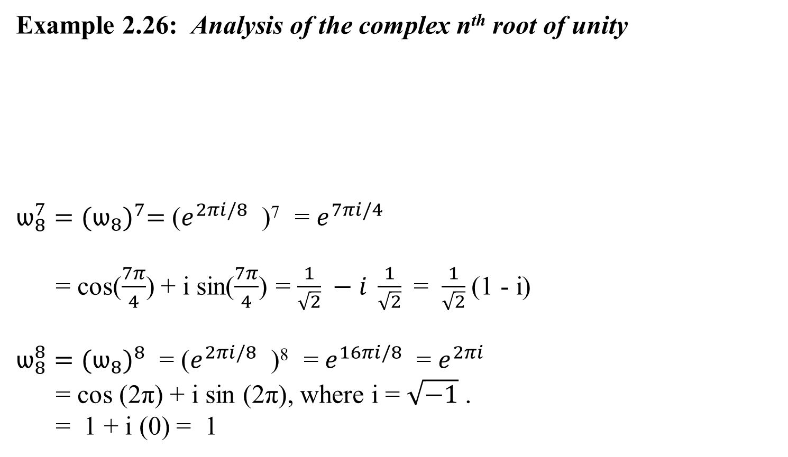
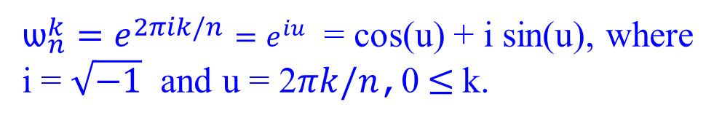
Example 2.26: Analysis of the complex n^{th} root of unity
$ѡ_{8}^{7}={(ѡ_{8})}^{7}=$($e^{2πi/8}$ )⁷ = $e^{7πi/4}$
= cos($\frac{7π}{4}$) + i sin($\frac{7π}{4}$) = $\frac{1}{\sqrt{2}} −i \frac{1}{\sqrt{2}}$ = $\frac{1}{\sqrt{2}}$(1 - i)
$ѡ_{8}^{8}={(ѡ_{8})}^{8}$ = ($e^{2πi/8}$ )⁸ = $e^{16πi/8}$ = $e^{2πi}$
= cos (2π) + i sin (2π), where i = $\sqrt{−1}$ .
= 1 + i (0) = 1
cos 0 = 1 sin 0 = 0
cos $\frac{π}{4}$ = $\frac{1}{\sqrt{2}}$ sin $\frac{π}{4}$ = $\frac{1}{\sqrt{2}}$
cos $\frac{π}{2}$ = 0 sin $\frac{π}{2}$ = 1
cos $\frac{3π}{4}$ =- $\frac{1}{\sqrt{2}}$ sin $\frac{3π}{4}$ = $\frac{1}{\sqrt{2}}$
cos π = -1 sin π = 0
cos $\frac{5π}{4}$ =- $\frac{1}{\sqrt{2}}$ sin $\frac{5π}{4}$ = - $\frac{1}{\sqrt{2}}$
cos $\frac{3π}{2}$ = 0 sin $\frac{3π}{2}$ = -1
cos $\frac{7π}{4}$ = $\frac{1}{\sqrt{2}}$ sin $\frac{7π}{4}$ = - $\frac{1}{\sqrt{2}}$
cos 2π = 1 sin 2π = 0
${ѡ_{n}^{k}=e^{2πik/n}=e}^{iu}$ = cos(u) + i sin(u), where
i = $\sqrt{−1}$ and u = 2$πk/n$,0$≤$k.

Slide 19


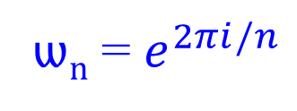

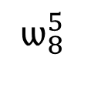


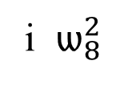

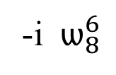
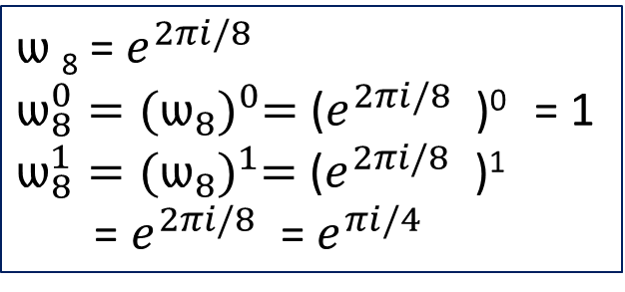


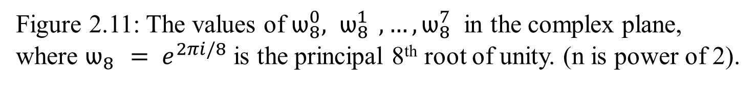
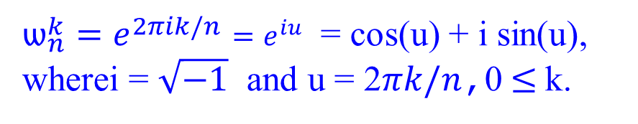



${ѡ_{n}^{k}=e^{2πik/n}=e}^{iu}$ = cos(u) + i sin(u), wherei = $\sqrt{−1}$ and u = 2$πk/n$,0$≤$k.
ѡ_{n} = $e^{2πi/n}$
$ѡ$₈ = $e^{2πi/8}$
$ѡ_{8}^{0}={(ѡ_{8})}^{0}=$($e^{2πi/8}$ )⁰ = 1
$ѡ_{8}^{1}={(ѡ_{8})}^{1}=$($e^{2πi/8}$ )¹
= $e^{2πi/8}$ = $e^{πi/4}$
i $ѡ_{8}^{2}$
$$\frac{π}{2}$$
$$\frac{3π}{4}$$
$ѡ_{8}^{3}$
$$\frac{π}{4}$$
$$ѡ_{8}^{1}$$
$$ѡ_{8}^{4}$$
$$ѡ_{8}^{0}= ѡ_{8}^{8}$$
0π
π
-1
1
2π
$$ѡ_{8}^{7}$$
$$\frac{7π}{4}$$
$$\frac{5π}{4}$$
${ ѡ}_{8}^{5}$
-i $ѡ_{8}^{6}$
$$\frac{3π}{2}$$
Figure 2.11: The values of $ѡ_{8}^{0}{, ѡ}_{8}^{1} , …, ѡ_{8}^{7}$ in the complex plane, where $ѡ_{8 }{= e}^{2πi/8}$ is the principal 8th root of unity. (n is power of 2).

Slide 20
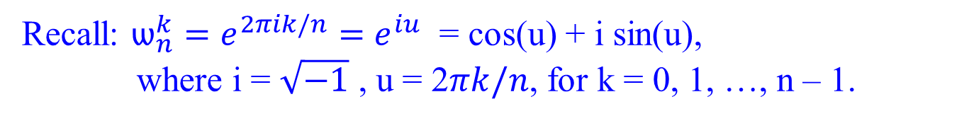

Complex roots of unity
Recall: $ѡ_{n}^{k}=e^{2πik/n}=$ $e^{iu}$ = cos(u) + i sin(u),
where i = $\sqrt{−1}$ , u = 2$πk/n$, for k = 0, 1, …, n – 1.
The n complex n^{th} roots of unity, $ѡ_{n}^{0}, { ѡ}_{n}^{1}, …, { ѡ}_{n}^{n−1},$ form a group under multiplication.
This group has the same structure as the additive group (Z_{n}, +) modulo n, since $ѡ_{n}^{n} = ѡ_{n}^{0} =1$ implies that
$$ѡ_{n}^{j} ѡ_{n}^{k}= ѡ_{n}^{j+k}= ѡ_{n}^{\left(j+k\right)mod n}.$$
Similarly, $ѡ_{n}^{−1}= ѡ_{n}^{n−1}.$

Slide 21
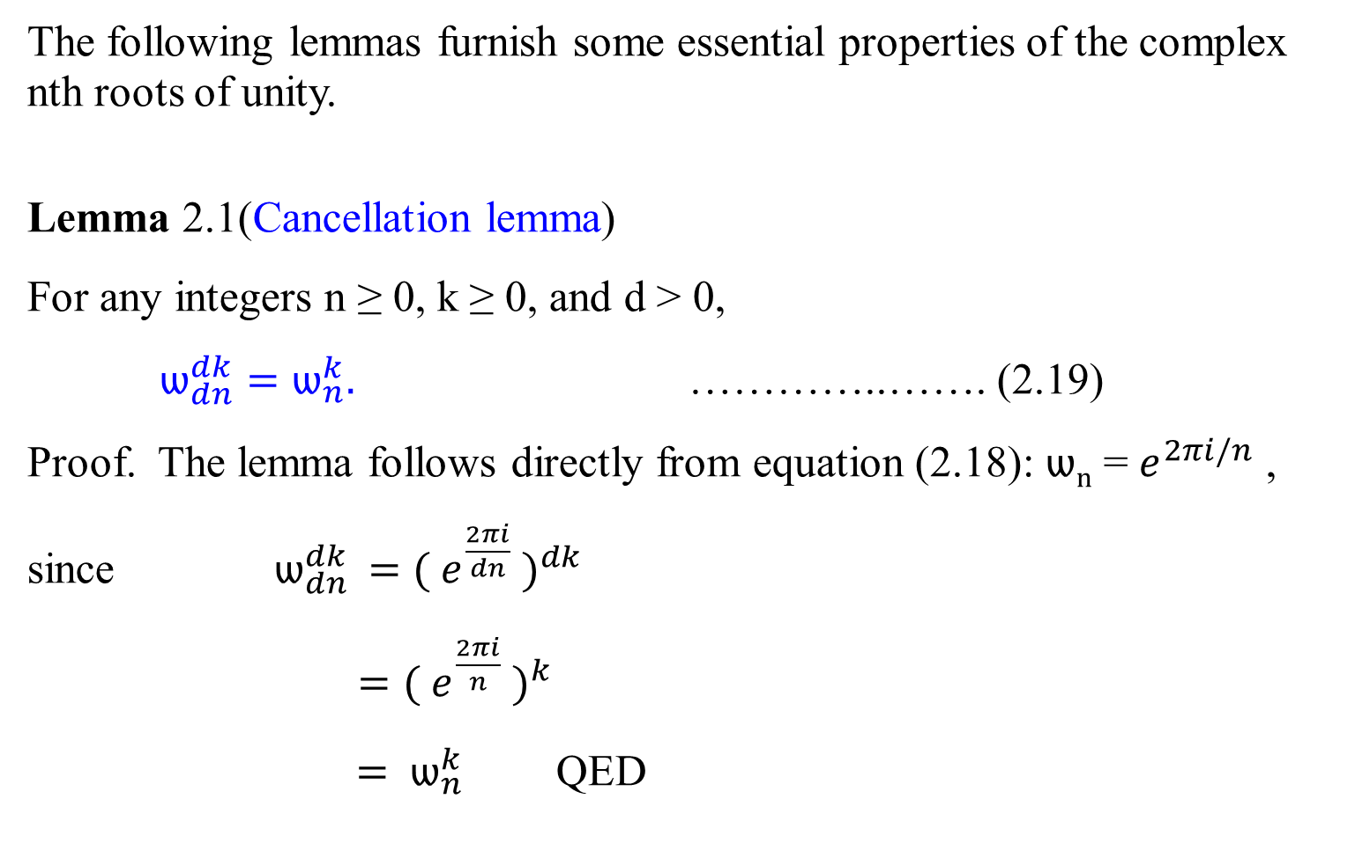
Complex roots of unity
The following lemmas furnish some essential properties of the complex nth roots of unity.
Lemma 2.1(Cancellation lemma)
For any integers n ≥ 0, k ≥ 0, and d > 0,
$ѡ_{dn}^{dk}=ѡ_{n}^{k}.$ …………..……. (2.19)
Proof. The lemma follows directly from equation (2.18): ѡ_{n} = $e^{2πi/n}$ ,
since ${ ѡ}_{dn}^{dk} =( e^{\frac{2πi}{dn}}{ )}^{dk}$
$=( e^{\frac{2πi}{n}}{ )}^{k}$
${ = ѡ}_{n}^{k}$ QED

Slide 22
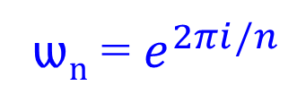

Complex roots of unity
Corollary 2.1.1
For any even integer n > 0,
$$ѡ_{n}^{n/2}= ѡ_{2}= −1.$$
Proof: $ѡ_{n}^{n/2}=( e^{\frac{2πi}{n}}{ )}^{\frac{n}{2}}= ( e^{\frac{2πi}{2}} )=ѡ_{2}= −1,$
for cos($π)+ i\sin\left(π\right)=−1+i∗0= −1$[ using e^{iu} = cos(u) + i sin(u)]. Or ${ ѡ}_{n}^{n/2}={ ѡ}_{2n}^{2n/2}= { ѡ}_{2n}^{n}= ѡ_{2}= −1.$
ѡ_{n} = $e^{2πi/n}$

Slide 23
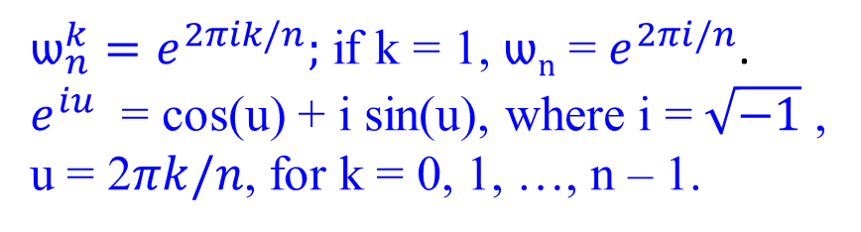
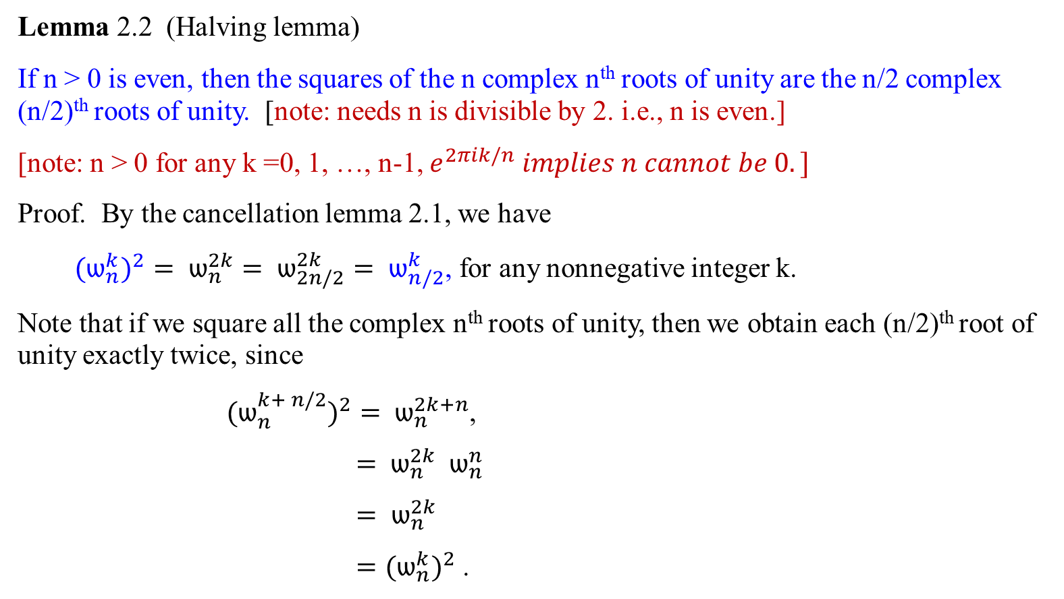
Complex roots of unity
$ѡ_{n}^{k}=e^{2πik/n};$ if k = 1, ѡ_{n} = $e^{2πi/n}$.
$e^{iu}$ = cos(u) + i sin(u), where i = $\sqrt{−1}$ ,
u = 2$πk/n$, for k = 0, 1, …, n – 1.
FFT
Lemma 2.2 (Halving lemma)
If n > 0 is even, then the squares of the n complex n^{th} roots of unity are the n/2 complex (n/2)^{th} roots of unity. [note: needs n is divisible by 2. i.e., n is even.]
[note: n > 0 for any k =0, 1, …, n-1, $e^{2πik/n} implies n cannot be 0.]$
Proof. By the cancellation lemma 2.1, we have
${{ (ѡ}_{n}^{k})}^{2}= ѡ_{n}^{2k}= ѡ_{2n/2}^{2k}= ѡ_{n/2}^{k}$, for any nonnegative integer k.
Note that if we square all the complex n^{th} roots of unity, then we obtain each (n/2)^{th} root of unity exactly twice, since
${{ (ѡ}_{n}^{k+ n/2})}^{2}= ѡ_{n}^{2k+n}$,
${ = ѡ}_{n}^{2k} { ѡ}_{n}^{n}$
${ = ѡ}_{n}^{2k}$
${ =(ѡ}_{n}^{k})^{2}$ .

Slide 24
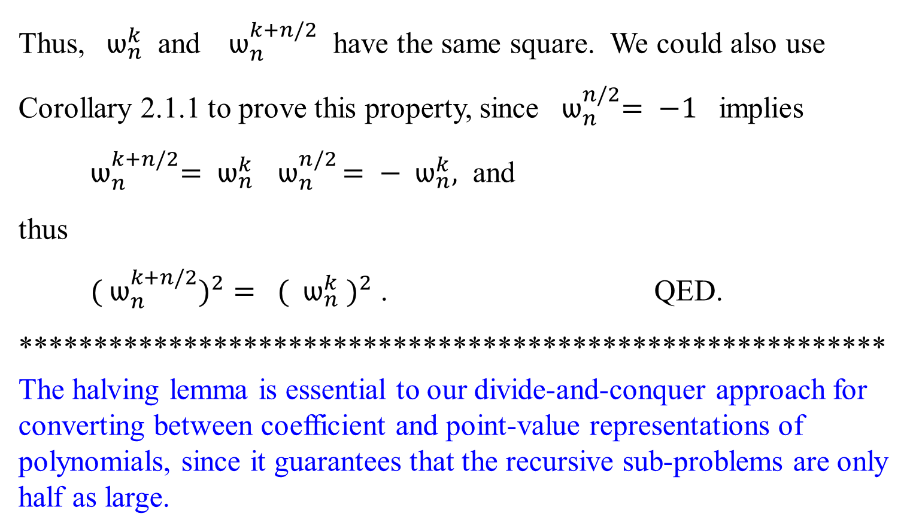
Complex roots of unity
Thus, ${ ѡ}_{n}^{k}$ and ${ ѡ}_{n}^{k+n/2}$ have the same square. We could also use Corollary 2.1.1 to prove this property, since ${ ѡ}_{n}^{n/2}= −1$ implies
${ ѡ}_{n}^{k+n/2}= ѡ_{n}^{k}{ ѡ}_{n}^{n/2}= −{ ѡ}_{n}^{k},$ and
thus
${ ( ѡ}_{n}^{k+n/2})^{2}= ({ ѡ}_{n}^{k} )^{2}$ . QED.
**********************************************************
The halving lemma is essential to our divide-and-conquer approach for converting between coefficient and point-value representations of polynomials, since it guarantees that the recursive sub-problems are only half as large.
FFT

Slide 25
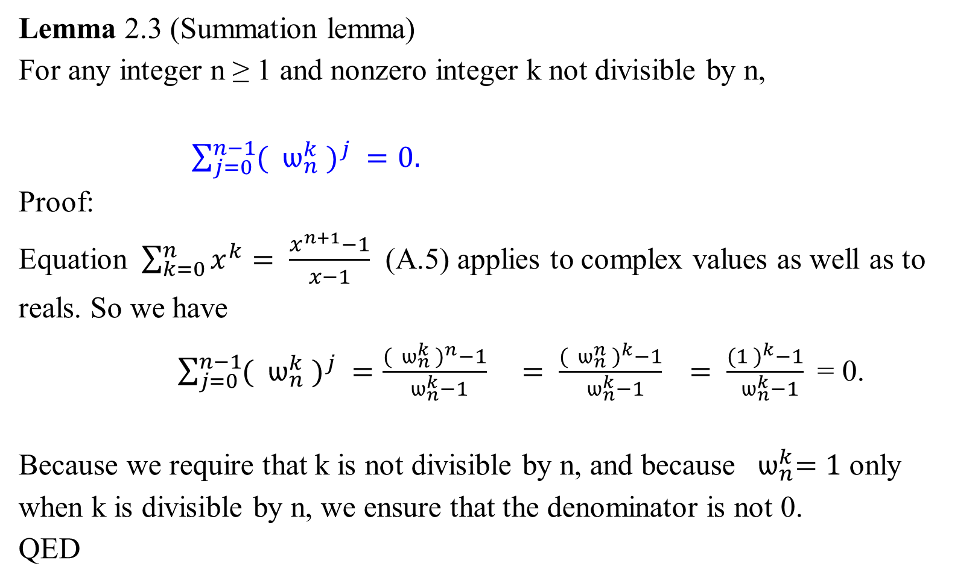
Complex roots of unity
Lemma 2.3 (Summation lemma)
For any integer n ≥ 1 and nonzero integer k not divisible by n,
$\sum_{j=0}^{n−1}{({ ѡ}_{n}^{k} )^{j} }=0.$
Proof:
Equation $\sum_{k=0}^{n}{x^{k}= \frac{x^{n+1}−1}{x−1}}$ (A.5) applies to complex values as well as to reals. So we have
$\sum_{j=0}^{n−1}{({ ѡ}_{n}^{k} )^{j} }=\frac{({ ѡ}_{n}^{k} )^{n}−1}{{ ѡ}_{n}^{k}−1}$ $= \frac{({ ѡ}_{n}^{n} )^{k}−1}{{ ѡ}_{n}^{k}−1}$ $= \frac{(1 )^{k}−1}{{ ѡ}_{n}^{k}−1}$= 0.
Because we require that k is not divisible by n, and because ${ ѡ}_{n}^{k}=1$ only when k is divisible by n, we ensure that the denominator is not 0.
QED
DFT

Slide 26
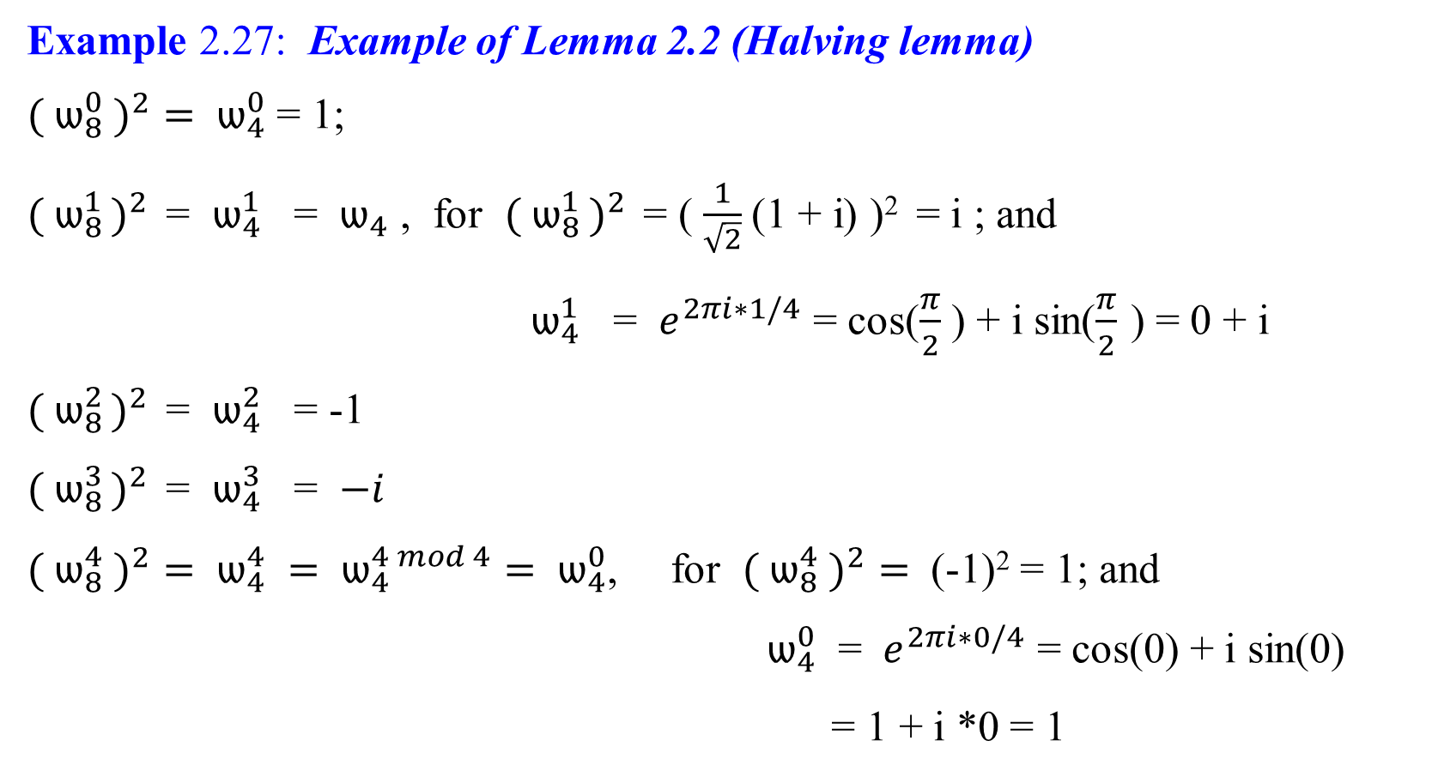
Complex roots of unity
FFT
Example 2.27: Example of Lemma 2.2 (Halving lemma)
${( ѡ}_{8}^{0} )^{2}= ѡ_{4}^{0}$ = 1;
${( ѡ}_{8 }^{1})^{2 }$ = $ѡ_{4}^{1}$ = $ѡ_{4}$ , for ${( ѡ}_{8 }^{1})^{2 }$ = ( $\frac{1}{\sqrt{2}}$(1 + i) )² = i ; and
$ѡ_{4}^{1}$ = $e^{2πi∗1/4}$ = cos($\frac{π}{2}$ ) + i sin($\frac{π}{2}$ ) = 0 + i
${( ѡ}_{8 }^{2})^{2 }$ = $ѡ_{4}^{2}$ = -1
${( ѡ}_{8 }^{3})^{2 }$ = $ѡ_{4}^{3}$ = $−i$
${( ѡ}_{8}^{4} )^{2}= ѡ_{4}^{4} = ѡ_{4}^{4 mod 4}= ѡ_{4}^{0}$, for ${( ѡ}_{8}^{4} )^{2}=$ (-1)² = 1; and
$ѡ_{4}^{0}$ = $e^{2πi∗0/4}$ = cos(0) + i sin(0)
= 1 + i *0 = 1

Slide 27

Complex roots of unity
…
($ѡ_{8}^{7}$ $)^{2}$ = $ѡ_{4}^{7}$ = $ѡ_{4}^{7 mod 4}$ = $ѡ_{4}^{3}$ , for ($ѡ_{8}^{7}$ $)^{2}$ = ( $\frac{1}{\sqrt{2}}$(1 - i) )² = -i; and
$ѡ_{4}^{3}= e^{2πi∗3/4}= e^{3πi/2}$
= cos($\frac{3π}{2}$) + i sin($\frac{3π}{2}$)
= 0 + i *-1 = -i
FFT

Slide 28

Complex roots of unity
DFT
Example 2.28: Example of Lemma 2.3 (Summation lemma)
$\sum_{j=0}^{n−1}{({ ѡ}_{n}^{k} )^{j} }=0.$
= ${( ѡ}_{n}^{k}{ )}^{0}+ ({ ѡ}_{n}^{k}{ )}^{1}$ $+ ( ѡ_{n}^{k} )^{2}$ $+ ( ѡ_{n}^{k} )^{3}$ $+ …$ $+ ( ѡ_{n}^{k}{ )}^{n−1}$
= $ѡ_{n}^{k∗0}+ ѡ_{n}^{k∗1}$ $+ ѡ_{n}^{k∗2}$ $+ ѡ_{n}^{k∗3}$ $+ …$ $+ ѡ_{n}^{k∗n−1}$
Let k = 3 and n = 8. 3 is indivisible by 8
$\sum_{j=0}^{n−1}{({ ѡ}_{n}^{k} )^{j} }$
${= ( ѡ}_{8}^{3}{ )}^{0}+ ({ ѡ}_{8}^{3}{ )}^{1}$ $+ ( ѡ_{8}^{3} )^{2}$ $+ ( ѡ_{8}^{3} )^{3}$ $+ …$ $+ ( ѡ_{8}^{3}{ )}^{7}$
= $ѡ_{8}^{3∗0}+ ѡ_{8}^{3∗1}$ $+ ѡ_{8}^{3∗2}$ $+ ѡ_{8}^{3∗3}$ $+ ѡ_{8}^{3∗4}$ $+ ѡ_{8}^{3∗5}$ $+ ѡ_{8}^{3∗6}$ $+ ѡ_{8}^{3∗7}$

Slide 29

Complex roots of unity
Example 2.28: Example of Lemma 2.3 (Summation lemma)
= …
= $ѡ_{8}^{3∗0}+ ѡ_{8}^{3∗1}$ $+ ѡ_{8}^{3∗2}$ $+ ѡ_{8}^{3∗3}$ $+ ѡ_{8}^{3∗4}$ $+ ѡ_{8}^{3∗5}$ $+ ѡ_{8}^{3∗6}$ $+ ѡ_{8}^{3∗7}$
= $(ѡ_{8}^{0})^{3}+ (ѡ_{8}^{1})^{3}$ $+ (ѡ_{8}^{2})^{3}$ $+ (ѡ_{8}^{3})^{3}+ (ѡ_{8}^{4})^{3}$ $+ (ѡ_{8}^{5}{ )}^{3}$ $+ (ѡ_{8}^{6})^{3}$ $+ (ѡ_{8}^{7})^{3}$
= $(1)^{3}+ (\frac{1}{\sqrt{2}} \left(1 + i\right))^{3}+ (i)^{3}+(\frac{1}{\sqrt{2}} \left(−1 + i\right))^{3}+$
$(−1)^{3}+ (\frac{1}{\sqrt{2}} (−1 − i))^{3}+(−i)^{3}+(\frac{1}{\sqrt{2}}$(1 - i)$)^{3}$
= 0
In fact, if k = 1, 2, 3, 4, 5, 6, 7, … k is indivisible by 8, and $\sum_{j=0}^{n−1}{({ ѡ}_{n}^{k} )^{j} }=0.$

Slide 30


Evaluate a polynomial A(x)
Example 2.29
1 x₀ $x_{0}^{2}$ … $x_{0}^{n−1}$ a₀ y₀
1 x₁ $x_{1}^{2}$ … $x_{1}^{n−1}$ a₁ y₁
. . . . . . .
1 x_{k} $x_{k}^{2}$ … $x_{k}^{n−1}$ a_{k} = y_{k} …. (2.16)
. . . . . . .
1 x_{n-1} $x_{n−1}^{2}$ … $x_{n−1}^{n−1}$ a_{n-1} y_{n-1}
y_{k} = a₀ *1 + a₁ * x_{k} + a₂ * $x_{k}^{2}$ + … + a_{n-1} * $x_{k}^{n−1}$
When k = 1, then
y₁ = a₀ *1 + a₁ * x₁ + a₂ * $x_{1}^{2}$ + … + a_{n-1} * $x_{1}^{n−1}$
The Vandermonde matrix could be evaluated at x₀ = $ѡ_{n}^{0}, { \text{x}\text{1}\text{ =} ѡ}_{n}^{1}, …, {\text{x}\text{n}\text{ =}ѡ}_{n}^{n−1}.$

Slide 31

Evaluate a polynomial A(x)-Interpolation at the complex roots of unity
The DFT
Evaluate a polynomial A(x) = $\sum_{j=0}^{n−1}{a_{j}x^{j}}$ of degree-bound n at $ѡ_{n}^{0}, { ѡ}_{n}^{1}, …, ѡ_{n}^{n−1}$, i.e., at the n complex n^{th} roots of unity).
Given A(x) in coefficient form: a = ($a_{0}, a_{1}, …, { a}_{n−1}$),
define the result y_{k} , for k = 0, 1, 2, …, n – 1, by
y_{k} $=$ A(${ ѡ}_{n}^{k}$)
$= \sum_{j=0}^{n−1}{{ a_{j} ѡ}_{n}^{kj} }$. …………….. (2.20)
i.e., y_{k} = a₀ *1 + a₁ * x_{k} + a₂ * $x_{k}^{2}$ + … + a_{n-1} * $x_{k}^{n−1}$
= ${ a_{0} ѡ}_{n}^{k∗0}$+ ${ a_{1} ѡ}_{n}^{k∗1}$ + ${ a_{2} ѡ}_{n}^{k∗2}$ + … + ${ a_{n−1} ѡ}_{n}^{k∗(n−1)}$
The vector y = ($y_{0}, y_{1}, …, { y}_{n−1}$) is the discrete Fourier transform (DFT) of the coefficient vector a = ($a_{0}, a_{1}, …, { a}_{n−1}$).
We also write y = DFT_{n} (a).
DFT

Slide 32
















$ѡ$₈ = $e^{2πi/8}$
$ѡ_{8}^{0} \text{=} {(ѡ_{8})}^{0} \text{=}$ ($e^{2πi/8}$ )⁰
= 1
$ѡ_{8}^{1 }\text{=}{ (ѡ_{8})}^{1} \text{=}$($e^{2πi/8}$ )¹
= $e^{2πi/8}$
i $ѡ_{8}^{2}$
$$\frac{π}{2}$$
$$\frac{3π}{4}$$
$ѡ_{8}^{3}$
$$\frac{π}{4}$$
$$ѡ_{8}^{1}$$
$$ѡ_{8}^{4}$$
$$ѡ_{8}^{0}= ѡ_{8}^{8}$$
0π
π
-1
1
2π
$$ѡ_{8}^{7}$$
$$\frac{7π}{4}$$
$$\frac{5π}{4}$$
${ ѡ}_{8}^{5}$
-i $ѡ_{8}^{6}$
$$\frac{3π}{2}$$
Figure 2.11: The values of $ѡ_{8}^{0}{, ѡ}_{8}^{1} , …, ѡ_{8}^{7}$ in the complex plane, where $ѡ_{8 }{= e}^{2πi/8}$ is the principal 8th root of unity.

Slide 33

Evaluate a polynomial A(x) - Interpolation at the complex roots of unity
FFT
Example 2.30: for n = 8
For k = 0, y₀ = y_{k} = A(${ ѡ}_{n}^{k}$) = A(${ ѡ}_{8}^{0}$) $= \sum_{j=0}^{n−1}{{ a_{j} ѡ}_{n}^{kj} }$ $= \sum_{j=0}^{8−1}{{ a_{j} ѡ}_{8}^{0j} }$
= $a_{0} ѡ_{8}^{0∗0}+ a_{1} ѡ_{8}^{0∗1}$ $+ a_{2} ѡ_{8}^{0∗2}$ $+ a_{3} ѡ_{8}^{0∗3}$ $+ a_{4} ѡ_{8}^{0∗4}$
$+ a_{5} ѡ_{8}^{0∗5}$ $+ a_{6} ѡ_{8}^{0∗6}$ $+ a_{7} ѡ_{8}^{0∗7}$
= $a_{0} (ѡ_{8}^{0})^{0}+ a_{1} (ѡ_{8}^{1})^{0}$ $+ a_{2} (ѡ_{8}^{2})^{0}$ $+ a_{3} (ѡ_{8}^{3})^{0}+ a_{4} (ѡ_{8}^{4})^{0}$
$+ a_{5} (ѡ_{8}^{5}{ )}^{0}$ $+ a_{6} (ѡ_{8}^{6})^{0}$ $+ a_{7} (ѡ_{8}^{7})^{0}$
= $a_{0}+ a_{1}+ a_{2}+a_{3}+a_{4}+a_{5}+a_{6}+{ a}_{7}$.

Slide 34

Evaluate a polynomial A(x)
FFT
For k = 1, y₁ = y_{k} = A(${ ѡ}_{n}^{k}$) = A(${ ѡ}_{8}^{1}$) $= \sum_{j=0}^{n−1}{{ a_{j} ѡ}_{n}^{kj} }$ $= \sum_{j=0}^{8−1}{{ a_{j} ѡ}_{8}^{1j} }$
= $a_{0} ѡ_{8}^{1∗0}+ a_{1} ѡ_{8}^{1∗1}$ $+ a_{2} ѡ_{8}^{1∗2}$ $+ a_{3} ѡ_{8}^{1∗3}$ $+ a_{4} ѡ_{8}^{1∗4}$
$+ a_{5} ѡ_{8}^{1∗5}$ $+ a_{6} ѡ_{8}^{1∗6}$ $+ a_{7} ѡ_{8}^{1∗7}$
= $a_{0} (ѡ_{8}^{0})^{1}+ a_{1} (ѡ_{8}^{1})^{1}$ $+ a_{2} (ѡ_{8}^{2})^{1}$ $+ a_{3} (ѡ_{8}^{3})^{1}+ a_{4} (ѡ_{8}^{4})^{1}$
$+ a_{5} (ѡ_{8}^{5}{ )}^{1}$ $+ a_{6} (ѡ_{8}^{6})^{1}$ $+ a_{7} (ѡ_{8}^{7})^{1}$
= $a_{0}\left(1\right)+ a_{1}\left(\frac{1}{\sqrt{2}} \left(1 + i\right)\right)+ a_{2}\left(i\right)+a_{3}\left(\frac{1}{\sqrt{2}} \left(−1 + i\right)\right)+$
$a_{4}(−1)+a_{5}(\frac{1}{\sqrt{2}} (−1 − i))+a_{6}(−i)+{ a}_{7}(\frac{1}{\sqrt{2}}$(1 - i)).

Slide 35

Evaluate a polynomial A(x)
For k = 2, y₂ = y_{k} = A(${ ѡ}_{n}^{k}$) = A(${ ѡ}_{8}^{2}$) $= \sum_{j=0}^{n−1}{{ a_{j} ѡ}_{n}^{kj} }$ $= \sum_{j=0}^{8−1}{{ a_{j} ѡ}_{8}^{2j} }$
= $a_{0} ѡ_{8}^{2∗0}+ a_{1} ѡ_{8}^{2∗1}$ $+ a_{2} ѡ_{8}^{2∗2}$ $+ a_{3} ѡ_{8}^{2∗3}$ $+ a_{4} ѡ_{8}^{2∗4}$
$+ a_{5} ѡ_{8}^{2∗5}$ $+ a_{6} ѡ_{8}^{2∗6}$ $+ a_{7} ѡ_{8}^{2∗7}$
= $a_{0} (ѡ_{8}^{0})^{2}+ a_{1} (ѡ_{8}^{1})^{2}$ $+ a_{2} (ѡ_{8}^{2})^{2}$ $+ a_{3} (ѡ_{8}^{3})^{2}+ a_{4} (ѡ_{8}^{4})^{2}$
$+ a_{5} (ѡ_{8}^{5}{ )}^{2}$ $+ a_{6} (ѡ_{8}^{6})^{2}$ $+ a_{7} (ѡ_{8}^{7})^{2}$
= $a_{0}(1)^{2}+ a_{1}(\frac{1}{\sqrt{2}} \left(1 + i\right))^{2}+ a_{2}(i)^{2}+a_{3}(\frac{1}{\sqrt{2}} \left(−1 + i\right))^{2}+$
${ a}_{4}(−1)^{2}+a_{5}(\frac{1}{\sqrt{2}} (−1 − i))^{2}+a_{6}(−i)^{2}+{ a}_{7}(\frac{1}{\sqrt{2}}$(1 - i)$)^{2}$.

Slide 36

Evaluate a polynomial A(x)
For k = 3, y₃ = y_{k} = A(${ ѡ}_{n}^{k}$) = A(${ ѡ}_{8}^{3}$) $= \sum_{j=0}^{n−1}{{ a_{j} ѡ}_{n}^{kj} }$ $= \sum_{j=0}^{8−1}{{ a_{j} ѡ}_{8}^{3j} }$
= $a_{0} ѡ_{8}^{3∗0}+ a_{1} ѡ_{8}^{3∗1}$ $+ a_{2} ѡ_{8}^{3∗2}$ $+ a_{3} ѡ_{8}^{3∗3}$ $+ a_{4} ѡ_{8}^{3∗4}$
$+ a_{5} ѡ_{8}^{3∗5}$ $+ a_{6} ѡ_{8}^{3∗6}$ $+ a_{7} ѡ_{8}^{3∗7}$
= $a_{0} (ѡ_{8}^{0})^{3}+ a_{1} (ѡ_{8}^{1})^{3}$ $+ a_{2} (ѡ_{8}^{2})^{3}$ $+ a_{3} (ѡ_{8}^{3})^{3}+ a_{4} (ѡ_{8}^{4})^{3}$
$+ a_{5} (ѡ_{8}^{5}{ )}^{3}$ $+ a_{6} (ѡ_{8}^{6})^{3}$ $+ a_{7} (ѡ_{8}^{7})^{3}$
= $a_{0}(1)^{3}+ a_{1}(\frac{1}{\sqrt{2}} \left(1 + i\right))^{3}+ a_{2}(i)^{3}+a_{3}(\frac{1}{\sqrt{2}} \left(−1 + i\right))^{3}+$
${ a}_{4}(−1)^{3}+a_{5}(\frac{1}{\sqrt{2}} (−1 − i))^{3}+a_{6}(−i)^{3}+{ a}_{7}(\frac{1}{\sqrt{2}}$(1 - i)$)^{3}$.

Slide 37

Evaluate a polynomial A(x)
FFT
For k = 4, y₄ = y_{k} = A(${ ѡ}_{n}^{k}$) = A(${ ѡ}_{8}^{4}$) $= \sum_{j=0}^{n−1}{{ a_{j} ѡ}_{n}^{kj} }$ $= \sum_{j=0}^{8−1}{{ a_{j} ѡ}_{8}^{4j} }$
= $a_{0} ѡ_{8}^{4∗0}+ a_{1} ѡ_{8}^{4∗1}$ $+ a_{2} ѡ_{8}^{4∗2}$ $+ a_{3} ѡ_{8}^{4∗3}$ $+ a_{4} ѡ_{8}^{4∗4}$
$+ a_{5} ѡ_{8}^{4∗5}$ $+ a_{6} ѡ_{8}^{4∗6}$ $+ a_{7} ѡ_{8}^{4∗7}$
= $a_{0} (ѡ_{8}^{0})^{4}+ a_{1} (ѡ_{8}^{1})^{4}$ $+ a_{2} (ѡ_{8}^{2})^{4}$ $+ a_{3} (ѡ_{8}^{3})^{4}+ a_{4} (ѡ_{8}^{4})^{4}$
$+ a_{5} (ѡ_{8}^{5}{ )}^{4}$ $+ a_{6} (ѡ_{8}^{6})^{4}$ $+ a_{7} (ѡ_{8}^{7})^{4}$
= $a_{0}(1)^{4}+ a_{1}(\frac{1}{\sqrt{2}} \left(1 + i\right))^{4}+ a_{2}(i)^{4}+a_{3}(\frac{1}{\sqrt{2}} \left(−1 + i\right))^{4}+$
$a_{4}(−1)^{4}+a_{5}(\frac{1}{\sqrt{2}} (−1 − i))^{4}+a_{6}(−i)^{4}+{ a}_{7}(\frac{1}{\sqrt{2}}$(1 - i)$)^{4}$.

Slide 38

Evaluate a polynomial A(x)
For k = 5, y₅ = y_{k} = A(${ ѡ}_{n}^{k}$) = A(${ ѡ}_{8}^{5}$) $= \sum_{j=0}^{n−1}{{ a_{j} ѡ}_{n}^{kj} }$ $= \sum_{j=0}^{8−1}{{ a_{j} ѡ}_{8}^{5j} }$
= $a_{0} ѡ_{8}^{5∗0}+ a_{1} ѡ_{8}^{5∗1}$ $+ a_{2} ѡ_{8}^{5∗2}$ $+ a_{3} ѡ_{8}^{5∗3}$ $+ a_{4} ѡ_{8}^{5∗4}$
$+ a_{5} ѡ_{8}^{5∗5}$ $+ a_{6} ѡ_{8}^{5∗6}$ $+ a_{7} ѡ_{8}^{5∗7}$
= $a_{0} (ѡ_{8}^{0})^{5}+ a_{1} (ѡ_{8}^{1})^{5}$ $+ a_{2} (ѡ_{8}^{2})^{5}$ $+ a_{3} (ѡ_{8}^{3})^{5}+ a_{4} (ѡ_{8}^{4})^{5}$
$+ a_{5} (ѡ_{8}^{5}{ )}^{5}$ $+ a_{6} (ѡ_{8}^{6})^{5}$ $+ a_{7} (ѡ_{8}^{7})^{5}$
= $a_{0}(1)^{5}+ a_{1}(\frac{1}{\sqrt{2}} \left(1 + i\right))^{5}+ a_{2}(i)^{5}+a_{3}(\frac{1}{\sqrt{2}} \left(−1 + i\right))^{5}+$
$a_{4}(−1)^{5}+a_{5}(\frac{1}{\sqrt{2}} (−1 − i))^{5}+a_{6}(−i)^{5}+{ a}_{7}(\frac{1}{\sqrt{2}}$(1 - i)$)^{5}$.

Slide 39

Evaluate a polynomial A(x)
For k = 6, y₆ = y_{k} = A(${ ѡ}_{n}^{k}$) = A(${ ѡ}_{8}^{6}$) $= \sum_{j=0}^{n−1}{{ a_{j} ѡ}_{n}^{kj} }$ $= \sum_{j=0}^{8−1}{{ a_{j} ѡ}_{8}^{6j} }$
= $a_{0} ѡ_{8}^{6∗0}+ a_{1} ѡ_{8}^{6∗1}$ $+ a_{2} ѡ_{8}^{6∗2}$ $+ a_{3} ѡ_{8}^{6∗3}$ $+ a_{4} ѡ_{8}^{6∗4}$
$+ a_{5} ѡ_{8}^{6∗5}$ $+ a_{6} ѡ_{8}^{6∗6}$ $+ a_{7} ѡ_{8}^{6∗7}$
= $a_{0} (ѡ_{8}^{0})^{6}+ a_{1} (ѡ_{8}^{1})^{6}$ $+ a_{2} (ѡ_{8}^{2})^{6}$ $+ a_{3} (ѡ_{8}^{3})^{6}+ a_{4} (ѡ_{8}^{4})^{6}$
$+ a_{5} (ѡ_{8}^{5}{ )}^{6}$ $+ a_{6} (ѡ_{8}^{6})^{6}$ $+ a_{7} (ѡ_{8}^{7})^{6}$
= $a_{0}(1)^{6}+ a_{1}(\frac{1}{\sqrt{2}} \left(1 + i\right))^{6}+ a_{2}(i)^{6}+a_{3}(\frac{1}{\sqrt{2}} \left(−1 + i\right))^{6}+$
$a_{4}(−1)^{6}+a_{5}(\frac{1}{\sqrt{2}} (−1 − i))^{6}+a_{6}(−i)^{6}+{ a}_{7}(\frac{1}{\sqrt{2}}$(1 - i)$)^{6}$.

Slide 40

Evaluate a polynomial A(x)
For k = 7, y₇ = y_{k} = A(${ ѡ}_{n}^{k}$) = A(${ ѡ}_{8}^{7}$) $= \sum_{j=0}^{n−1}{{ a_{j} ѡ}_{n}^{kj} }$ $= \sum_{j=0}^{8−1}{{ a_{j} ѡ}_{8}^{7j} }$
= $a_{0} ѡ_{8}^{7∗0}+ a_{1} ѡ_{8}^{7∗1}$ $+ a_{2} ѡ_{8}^{7∗2}$ $+ a_{3} ѡ_{8}^{7∗3}$ $+ a_{4} ѡ_{8}^{7∗4}$
$+ a_{5} ѡ_{8}^{7∗5}$ $+ a_{6} ѡ_{8}^{7∗6}$ $+ a_{7} ѡ_{8}^{7∗7}$
= $a_{0} (ѡ_{8}^{0})^{7}+ a_{1} (ѡ_{8}^{1})^{7}$ $+ a_{2} (ѡ_{8}^{2})^{7}$ $+ a_{3} (ѡ_{8}^{3})^{7}+ a_{4} (ѡ_{8}^{4})^{7}$
$+ a_{5} (ѡ_{8}^{5}{ )}^{7}$ $+ a_{6} (ѡ_{8}^{6})^{7}$ $+ a_{7} (ѡ_{8}^{7})^{7}$
= $a_{0}(1)^{7}+ a_{1}(\frac{1}{\sqrt{2}} \left(1 + i\right))^{7}+ a_{2}(i)^{7}+a_{3}(\frac{1}{\sqrt{2}} \left(−1 + i\right))^{7}+$
$a_{4}(−1)^{7}+a_{5}(\frac{1}{\sqrt{2}} (−1 − i))^{7}+a_{6}(−i)^{7}+{ a}_{7}(\frac{1}{\sqrt{2}}$(1 - i)$)^{7}$

Slide 41
Evaluate a polynomial A(x)
The FFT
The fast Fourier transform (FFT) method
takes advantage of the properties of the complex roots of unity and
compute DFT_{n} (a) in time Θ(n log n), as opposed to the Θ(n²) time of the straightforward method.
Assume throughout that n is an exact power of 2.
Although strategies for dealing with non-power-of-2 sizes are known, they are beyond the scope of this course.

Slide 42

Evaluate a polynomial A(x) - Interpolation at the complex roots of unity
Consider A(x) = $a_{0}x^{0}+ a_{1}x^{1}+ a_{2}x^{2}+ a_{3}x^{3}+ a_{4}x^{4}+…+ a_{n−1}x^{n−1}$ of degree-bound n polynomial.
The FFT method employs a divide-and-conquer strategy:
using the even-indexed and odd-indexed coefficients of A(x) separately,
define the two new polynomials A^{[0]} (x) and A^{[1]} (x) of degree-bound n/2:
A^{[0]} (x) = $a_{0}+ a_{2}x^{1}+a_{4}x^{2}+…+ a_{n−2}x^{\frac{n}{2} −1}$.
A^{[1]} (x) = $a_{1}+ a_{3}x^{1}+a_{5}x^{2}+…+ a_{n−1}x^{\frac{n}{2} −1}$.
A^{[0]} contains all the even-indexed coefficients of $a_{k}$ (the binary representation of the index ends in 0) and
A^{[1]} contains all the odd-indexed coefficients of $a_{k+1}$ (the binary representation of the index ends in 1).
FFT

Slide 43

Evaluate a polynomial A(x)
It follows that
A(x) = A^{[0]} (x²) + x *A^{[1]} (x²). …………….. (2.21)
so that the problem of evaluating A(x) at $ѡ_{n}^{0}, ѡ_{n}^{1}, …, ѡ_{n}^{n−1}$reduces to
evaluating the degree-bound n/2 polynomials A^{[0]} (x) and A^{[1]} (x) at the points
${(ѡ}_{n}^{0})^{2}, {(ѡ}_{n}^{1})^{2}, …, {(ѡ}_{n}^{n−1})^{2} ,$ …………… (2.22)
and then
2. combining the results according to equation (2.21).
FFT

Slide 44

Evaluate a polynomial A(x)
Example 2.31: Consider n = 8.
Let A(x) = $a_{0}x^{0}+ a_{1}x^{1}+ a_{2}x^{2}+ a_{3}x^{3}+ a_{4}x^{4}+…+ a_{n−1}x^{n−1}$ of degree-bound n polynomial.
Use the even-indexed and odd-indexed coefficients of A(x) separately to define the two new polynomials of degree n/2.
If n = 8, then
A(x) = $a_{0}x^{0}+ a_{1}x^{1}+a_{2}x^{2}+a_{3}x^{3}+a_{4}x^{4}+a_{5}x^{5}+a_{6}x^{6}+ a_{7}x^{7}$
If A^{[0]} (x) = $a_{0}+ a_{2}x^{1}+a_{4}x^{2}+ a_{6}x^{3}$ then
A^{[0]} (x²) = $a_{0}+ a_{2}{(x^{2})}^{1}+a_{4}({x^{2})}^{2}+ a_{6}({x^{2})}^{3}$
= $a_{0}+ a_{2}{(x^{1})}^{2}+a_{4}({x^{2})}^{2}+ a_{6}({x^{3})}^{2}$
= $a_{0}+ a_{2}x^{2}+a_{4}x^{4}+ a_{6}x^{6}$

Slide 45

Evaluate a polynomial A(x)
If n = 8, then
A(x) = $a_{0}x^{0}+ a_{1}x^{1}+a_{2}x^{2}+a_{3}x^{3}+a_{4}x^{4}+a_{5}x^{5}+a_{6}x^{6}+ a_{7}x^{7}$ .
If A^{[1]} (x) = $a_{1}+ a_{3}x^{1}+a_{5}x^{2}+ a_{7}x^{3}$, then
x*A^{[1]} (x²) = $x∗(a_{1}+ a_{3}{\left(x^{2}\right)}^{1}+a_{5}({x^{2})}^{2}+ a_{7}({x^{2})}^{3} )$
= $x∗(a_{1}+ a_{3}{\left(x^{1}\right)}^{2}+a_{5}({x^{2})}^{2}+ a_{7}({x^{3})}^{2} )$
= ${x∗(a}_{1}+ a_{3}x^{2}+a_{5}x^{4}+ a_{7}x^{6} )$
= ${(a}_{1}x+ a_{3}x^{2}x+a_{5}x^{4}x+ a_{7}x^{6} x)$
= ${ (a}_{1}x+ a_{3}x^{3}+a_{5}x^{5}+ a_{7}x^{7} )$

Slide 46

Evaluate a polynomial A(x)
So far we have
A^{[0]} (x²) = $a_{0}+ a_{2}x^{2}+a_{4}x^{4}+ a_{6}x^{6}$ , and
x*A^{[1]} (x²) = ${ (a}_{1}x+ a_{3}x^{3}+a_{5}x^{5}+ a_{7}x^{7} )$.
Then
A(x) = A^{[0]} (x²) + x * A^{[1]} (x²)
= ( $a_{0}+ a_{2}x^{2}+a_{4}x^{4}+ a_{6}x^{6}$ ) + ${ (a}_{1}x+ a_{3}x^{3}+a_{5}x^{5}+ a_{7}x^{7} )$
= $a_{0}+a_{1}x+ a_{2}x^{2}+ a_{3}x^{3}+a_{4}x^{4}+ a_{5}x^{5}+ a_{6}x^{6}+ a_{7}x^{7}$
Thus, A(x) = A^{[0]} (x²) + x *A^{[1]} (x²). …………….. (2.21)

Slide 47

Evaluate a polynomial A(x)
Therefore we can write, as shown in (2.21),
A(x) = A^{[0]} (x²) + x A^{[1]} (x²)
where A(x) = $a_{0}x^{0}+ a_{1}x^{1}+a_{2}x^{2}+a_{3}x^{3}+a_{4}x^{4}+…+ a_{n−1}x^{n−1}$ of degree-bound n;
A^{[0]} (x) = $a_{0}+ a_{2}x^{1}+a_{4}x^{2}+…+ a_{n−2}x^{\frac{n}{2} −1}$; and
A^{[1]} (x) = $a_{1}+ a_{3}x^{1}+a_{5}x^{2}+…+ a_{n−1}x^{\frac{n}{2} −1}$.

Slide 48

Evaluate a polynomial A(x)
This shows that the problem of evaluating A(x) at $ѡ_{n}^{0}, { ѡ}_{n}^{1}, …, ѡ_{n}^{n−1}$
(i.e., A(${ ѡ}_{n}^{k}$) $= \sum_{j=0}^{n−1}{{ a_{j} ѡ}_{n}^{kj} }$, k = 0, 1, 2, …, n-1 ……..(2.20) )
1. reduces to evaluating the degree-bound n/2 polynomials
A^{[0]} (x) and A^{[1]} (x) at the points ${(ѡ}_{n}^{0})^{2}, {(ѡ}_{n}^{1})^{2}, …, {(ѡ}_{n}^{n−1})^{2}$,
………(2.22)
and then
2. combining the results according to (2.21)
A(x) = A^{[0]} (x²) + x * A^{[1]} (x²) .
End of example 2.31

Slide 49

Evaluate a polynomial A(x) - Interpolation at the complex roots of unity
By the halving lemma, the list of values
${(ѡ}_{n}^{0})^{2}, {(ѡ}_{n}^{1})^{2}, …, {(ѡ}_{n}^{n−1})^{2}$ …..….(2.22)
consists not of n distinct values but only of the n/2 complex (n/2)^{th} roots of unity, with each root occurring exactly twice.
Therefore, recursively evaluate the polynomials A^{[0]} (x) and A^{[1]} (x) of degree-bound n/2 at the n/2 complex (n/2)^{th} roots of unity.
These subproblems have exactly the same form as the original problem, but are half the size.
We have successfully divided an n-element DFT_{n} computation into two n/2-element DFT_{n/2} computations.
This decomposition is the basis for the following recursive FFT algorithm, which computes the DFT of an n-element vector a = ($a_{0}, a_{1}, …, { a}_{n−1}$), where n is a power of 2.

Slide 50

Evaluate a polynomial A(x)
Recursive-FFT(a)
n = a.length; //n is a power of 2
if n == 1;
then return a;
ѡ_{n} = $e^{2πi/n}$;
ѡ = 1;
a^{[0]} = ($a_{0}, a_{2}, …, { a}_{n−2}$);
a^{[1]} = ($a_{1}, a_{3}, …, { a}_{n−1}$);
y^{[0]} = Recursive-FFT(a^{[0]} );
y^{[1]} = Recursive-FFT(a^{[1]} );
for k = 0 to n/2 – 1 {
y_{k} = $y_{k}^{[0]}+ ѡy_{k}^{[1]}$;
y_{k+(n/2)} = $y_{k}^{[0]}− ѡy_{k}^{[1]}$;
ѡ = ѡѡ_{n}; } //end for k = 0 loop
return y; //y is assumed to be a column vector

Slide 52
Interpolation at the complex roots of unity
Interpolation at the complex roots of unity
We now complete the polynomial multiplication scheme by showing
how to interpolate the complex roots of unity by a polynomial, which
enables us to convert from point-value form back to coefficient form.
We interpolate by
writing the DFT as a matrix equation and then
looking at the form of the matrix inverse.

Slide 53


From the equation (2.16) in Example 2.29,
1 x₀ $x_{0}^{2}$ … $x_{0}^{n−1}$ a₀ y₀
1 x₁ $x_{1}^{2}$ … $x_{1}^{n−1}$ a₁ y₁
. . . . . . .
. . . . . . = . …. (2.16)
. . . . . . .
1 x_{n-1} $x_{n−1}^{2}$ … $x_{n−1}^{n−1}$ a_{n-1} y_{n-1}
y_{k} = a₀ *1 + a₁ * x_{k} + a₂ * $x_{k}^{2}$ + … + a_{n-1} * $x_{k}^{n−1}$
When k = 1, then
y₁ = a₀ *1 + a₁ * x₁ + a₂ * $x_{1}^{2}$ + … + a_{n-1} * $x_{1}^{n−1}$
The Vandermonde matrix could be evaluated at $ѡ_{n}^{0}, { ѡ}_{n}^{1}, …, ѡ_{n}^{n−1}.$

Slide 54


We write the DFT as the matrix product y = V_{n}a, where
V_{n} is a Vandermonde matrix containing the appropriate powers of ѡ_{n}:
1 1 1 1 … 1 a₀ y₀
1 ѡ₀ $ѡ_{n}^{2}$ $ѡ_{n}^{3}$ … $ѡ_{n}^{n−1}$ a₁ y₁
1 $ѡ_{n}^{2}$ $ѡ_{n}^{4}$ $ѡ_{n}^{6}$ … $ѡ_{n}^{2(n−1)}$ a₂ y₂
1 $ѡ_{n}^{3}$ $ѡ_{n}^{6}$ $ѡ_{n}^{9}$ … $ѡ_{n}^{3(n−1)}$ a₄ = y₃
. . . . . .
. . . . . .
. . . . . .
1 $ѡ_{n}^{n−1}$ $ѡ_{n}^{2(n−1)}$ $ѡ_{n}^{3(n−1)}$… $ѡ_{n}^{(n−1)(n−1)}$ a_{n-1} y_{n-1}
The (k, j) entry of V_{n} is $ѡ_{n}^{kj}$ , for j, k = 0, 1, 2, …, n – 1.
The exponents of the entries of V_{n} form a multiplication table.

Slide 55

Interpolation at the complex roots of unity
For the inverse operation, which is written as a = ${DFT}_{n}^{−1}\left(y\right),$
then proceed by multiplying y by the matrix ${ V}_{n}^{−1},$ the inverse of V_{n} .
(a) = ${ V}_{n}^{−1}$ (y)
Use the following Theorem 2.6 to compute the inverse of V_{n} .
Theorem 2.6
For j, k = 0 $≤$ j, k $≤$ n – 1, the (j, k)-entry of ${ V}_{n}^{−1}$ is $ѡ_{n}^{−kj}/n$.

Slide 56

Interpolation at the complex roots of unity
For the inverse operation, which is written as a = ${DFT}_{n}^{−1}\left(y\right),$ we proceed by multiplying y by the matrix ${ V}_{n}^{−1},$ the inverse of V_{n} .
Theorem 2.6 For j, k = 0, 1, 2, …, n – 1, the (j, k) entry of ${ V}_{n}^{−1}$ is $ѡ_{n}^{−kj}/n$.
Proof. We show that ${ V}_{n}^{−1}V_{n}= I_{n} ,$ the n x n identity matrix.
Consider the (j, j’) entry of ${ V}_{n}^{−1}V_{n}:$
${ { [V}_{n}^{−1}V_{n} ]}_{j j′}$ = $\sum_{k=0}^{n−1}{( ѡ_{n}^{−kj} /n)(ѡ_{n}^{kj′}}$)
= $\sum_{k=0}^{n−1}{( ѡ_{n}^{k(j^{′}−j)} /n)}$.
The summation equals 1 if j’ = j, and it is 0 otherwise by the summation lemma (Lemma 2.3). Note that we rely on – (n – 1) ≤ j’ – j ≤ n – 1, so that j’ – j is not divisible by n, in order for the summation lemma to apply.
QED

Slide 57

Interpolation at the complex roots of unity
Given the inverse matrix ${ V}_{n}^{−1}$, we have that ${DFT}_{n}^{−1}\left(y\right)$ is given by
$a_{j}= \frac{1}{n} \sum_{k=0}^{n−1}{y_{k}ѡ_{n}^{−kj}}$ ………………….(2.23)
for j = 0, 1, 2, …., n-1.
By comparing equations (2.20) and (2.23), we see that by modifying the FFT algorithm to
switch the roles of a and y,
replace $ѡ_{n }$by $ѡ_{n}^{−1},$ and
divide each element of the result of n,
we compute the inverse DFT.
Thus, we can compute ${DFT}_{n}^{−1}$ in Θ(n log n) time.

Slide 58
Evaluation and Interpolation at the complex roots of unity
We see that,
by using the FFT and the inverse FFT,
we can transform a polynomial of degree-bound n back and forth between its coefficient representation and a point-value representation in time Θ(n log n).
In the context of polynomial multiplication, we have shown the following.

Slide 59

Theorem 2.7 (Convolution theorem)
For any two vectors a and b of length n, where n is a power of 2,
a $⊗$b = ${DFT}_{2n}^{−1}\left({DFT}_{2n}\left(a\right)∗{DFT}_{2n}(b)\right)$
where the vectors a and b are padded with 0’s to length 2n and * denotes the component-wise product of two 2n-element vectors.

Slide 60
Efficient FFT Implementation (for reference)
This section examines two efficient FFT implementations.
Examine an iterative version of the FFT algorithm that
runs in Θ(n log n) time but
have a lower constant hidden in the Θ-notation than the recursive version, Recursive-FFT in the section “The DFT and FFT”.
Then use the insights that led us to the iterative implementation to design an efficient parallel FFT circuit.
An iterative FFT implementation
Consider the Recursive-FFT algorithm:

Slide 61

Recursive-FFT(a)
n = a.length //n is a power of 2
if n == 1
return a
ѡ_{n} = $e^{2πi/n}$
ѡ = 1
a^{[0]} = ($a_{0}, a_{2}, …, { a}_{n−2}$)
a^{[1]} = ($a_{1}, a_{3}, …, { a}_{n−1}$)
y^{[0]} = Recursive-FFT(a^{[0]} )
y^{[1]} = Recursive-FFT(a^{[1]} )
for k = 0 to n/2 – 1
y_{k} = $y_{k}^{[0]}+ ѡy_{k}^{[1]}$
y_{k+(n/2)} = $y_{k}^{[0]}− ѡy_{k}^{[1]}$
ѡ = ѡѡ_{n}
return y //y is assumed to be a column vector

Slide 62

The for-loop of line 10-13 of Recursive-FFT involves computing the value ${ ѡ}_{n }^{k}y_{k}^{[1]}$ twice. In compiler terminology, we call such a value a common subexpression. We can change the loop to compute it only once, storing it in a temporary variable t.
for k = 0 to n/2 – 1
t = $ѡy_{k}^{[1]}$
y_{k} = $y_{k}^{[0]}+t$
y_{k+(n/2)} = $y_{k}^{[0]}− t$
ѡ = ѡѡ_{n}

Slide 63

The operation in this loop, multiplying the twiddle factor ѡ = ${ ѡ}_{n }^{k}$ by $y_{k}^{[1]}$, storing the product into t, and adding and subtracting t from $y_{k}^{[0]}$, is known as butterfly operation and is known schematically in Figure 2.12.

Slide 64

yk[0] ⨁ yk[0] + ѡn kyk[1]
ѡn k (a)
yk[1] ⊛ ⊖ yk[0] - ѡn kyk[1]
yk[0] yk[0] + ѡn kyk[1]
ѡn k (b)
yk[1] yk[0] - ѡn kyk[1]
Figure 2.12: 30.3 A butterfly operation. (a) The two input values enter from the left, the twiddle factor ${ ѡ}_{n }^{k}$ is multiplied by $y_{k}^{[1]}$, and the sum and difference are output on the right. (b) A simplified drawing of a butterly operation. We will us this representation in a parallel FFT circuit.

Slide 65
We now show how to make the FFT algorithm iterative rather than recursive in structure. In Figure 2.13, we have arranged the input vectors to the recursive calls in an invocation of Recursive-FFT in a tree structure, where the initial call is for n = 8. The tree has one node for each call of the procedure, labeled by the corresponding input vector. Each Recursive FFT invocation makes two recursive calls, unless it has received a 1-element vector. The first call appears in the left child, and the second call appears in the right child.

Slide 66















($a_{0}, a_{1}, a_{2}, a_{3}, { a}_{4}, a_{5}, { a}_{6},{ a}_{7}$)
($a_{0}, a_{2}, { a}_{4}, a_{6}$)
($a_{1}, a_{3}, { a}_{5}, a_{7}$)
($a_{0}, a_{4})$
($a_{2}, a_{6})$
($a_{1}, a_{5})$
($a_{3}, a_{7})$
($a_{0})$
($a_{4})$
($a_{2})$
($a_{6})$
($a_{1})$
($a_{5})$
($a_{3})$
($a_{7})$
Figure 2.13: The tree of input vectors to the recursive calls of the Recursive-FFT procedure. The initial invocation is for n = 8.

Slide 67
Looking at the tree, we observe that if we could arrange the elements of the initial vector a into the order in which they appear in the leaves, we could trace the execution of the Recursive-FFT procedure, but bottom up instead of top down. First we take the elements in pairs, compute the DFT of each pair using one butterfly operation, and replace the pair with its DFT. The vector then holds n/2 2-element DFTs. Next, we take these n/2 DFTs in pairs and compute the DFT of the four vector elements they come from by executing two butterfly operations, replacing two 2-element DFTs with one 4-element DFT. The vector then holds n/4 4-element DFTs. We continue in this manner until the vector holds two (n/2)-element DFTs, which we combine using n/2 butterfly operations into the final n-element DFT.

Slide 68
To turn this bottom-up approach into code, we use an array A[0 .. n – 1] that initially holds the elements of the input vector a in the order in which they appear in the leaves of the tree of 2.13. We shall show later how to determine this order, which is known as a bit-reversal permutation.) But we have to combine DFTs on each level of the tree, we introduce a variable s to count the levels, ranging from 1 (at the bottom, when we are combining pairs to form 2-element DFTs) to log n (at the top, when we are combining two (n/2)-element DFTs to produce the final result). The algorithm therefore has the following structure:

Slide 69
for s = 1 to log n
for k = 0 to n – 1 by 2^{s}
combine the two 2^{s-1}-element DFTs in
A[k, .. k + 2^{s-1} - 1] and A[k + 2^{s-1} .. k +2^{s} - 1]
into one 2^{s}-element DFT in A[k .. k + 2^{s} - 1]

Slide 70
We can express the body of the look (line 3) as more precise pseudocode. We copy the for-loop from the Recursive-FFT procedure, identifying y^{[0]} with A[k .. k + 2^{s-1} - 1] and y^{[1]} with A[k + 2^{s-1} .. k +2^{s} - 1]. The twiddle factor used in each butterfly operation depends on the value of s; it is a power of ѡ_{m}, where m = 2^{s}. (We introduce the variable m solely for the sake of readability.) We introduce another temporary variable u that allows us to perform the butterfly operation in place. When we replace line 3 of the overall structure by the loop body, we get the following pseudocode, which forms the basis of the parallel implementation we shall present later. The code first calls the auxiliary procedure Bit-Reverse-Copy(a, A) to copy vector a into array A in the initial order in which we need the values.

Slide 71

Iterative-FFT(a)
Bit-Reverse-Copy(a, A)
n = a.length //n is a power of 2
for s = 1 to log n
m = 2^{s}
ѡ_{m} = $e^{2πi/m}$
for k = 0 to n – 1 by m
ѡ = 1
for j = 0 to m/2 -1
t = ѡA[k + j + m/2]
u = A[k + j]
A[k + j] = u + t
A[k + j + m/2] = u – 1
ѡ = ѡ ѡ_{m}
return A

Slide 72
How does Bit-Reverse-Copy get the elements of the input vector a into the desired order in the array A? The order in which the leaves appear in Figure 2.13 is a bit-reverse permutation. That is, if we let rev(k) be the log n-bit integer formed by reversing the bits of the binary representation of k, then we want to place vector element ak in array position A[rev(k)]. In Figure 2.13, for example, the leaves appear in the order 0, 4, 2, 6, 1, 5, 3, 7; this sequence in binary is 000, 100, 010, 110, 001, 101, 011, 111, and when we reverse the bits of each value we get the sequence 000, 001, 010, 011, 100, 101, 110, 111. To see that we want n bit-reversal permutation in general, we note that at the top level of the tree, indices whose low-order bit is 0 go into the left subtree and indices whose low-order bit is 1 go into the right subtree. Stripping off the low-order bit at each level, we continue this process down the tree, until we get the order given by the bit-reversal permutation at the leaves.

Slide 73
Since we can easily compute the function rev(k), the Bit-Reverse-Copy procedure is simple:
Bit-Reverse-Copy(a, A)
n = a.length
for k = 0 to n – 1
A[rev(k)] = a_{k}

Slide 74
The iterative FFT implementation runs in time Θ(n log n). The call to Bit-Reverse-Copy(a, A) certainly runs in O(n log n) time, since we iterate n times and can reverse an integer between 0 to n – 1, with log n bits , in O( log n) time. (in practice, because we usually know the initial value of n in advance, we would probably code a table mapping k to rev(k), making Bit-Reverse-Copy run in Θ(n) time with a low hidden constant. Alternatively, we could use the clever amortized reverse binary counter scheme.) To complete the proof that Iterative-FFT runs in time Θ(n log n), we show that L(n), the number of times the body of the innermost loop (lines 8 -13) executes, is Θ(n log n). The for-loop of lines 6-13 iterates n/m = n/2^{s} times for each value of s, and the innermost loop of lines 8-13 iterates m/2 = 2^{s - 1} times. Thus,

Slide 75

L(n) = $\sum_{s=1}^{\log{n}}{\frac{n}{2^{s}}} . 2^{s−1}$
= $\sum_{s=1}^{\log{n}}{\frac{n}{2}}$
= Θ(n log n).

Slide 76
A parallel FFT circuit
We can exploit many of the properties that allowed us to implement an efficient iterative FFT algorithm to produce an efficient parallel algorithm for the FFT. We will express the parallel FFT algorithm as a circuit. Figure 2.14 shows a parallel FFT circuit, which computes the FFT on n inputs, for n = 8.

Slide 77












vvvvvvvvvvvvv
a₀ y₀
$$ѡ_{2}^{0}$$
a₁ y₁
$$ѡ_{4}^{0}$$
a₂ y₂
$$ѡ_{2}^{0}$$
$$ѡ_{4}^{1}$$
a₃ y₃
$${ ѡ}_{8}^{0}$$
a₄ y₄
$$ѡ_{2}^{0}$$
$${ ѡ}_{8}^{1}$$
a₅ y₅
$$ѡ_{4}^{0}$$
$${ ѡ}_{8}^{2}$$
a₆ y₆
$$ѡ_{2}^{0}$$
$$ѡ_{4}^{1}$$
$$ѡ_{8}^{3}$$
a₇ y₇
stage s = 1 stage s = 2 stage s = 3

Slide 78
Figure 2.14: A circuit that computes the FFT in parallel, her shown on n = 8 inputs. Each butterfly operation takes as input the values on two wires, along with a twiddle factor, and it produces as outputs the values on two wires. The stages on butterflies are labeled to correspond to iterations of the outermost loop of the Iterative-FFT procedure. Only the top and bottom wires passing through a butterfly interact with it; wires that pass through the middle of a butterfly do not affect that butterfly, nor are their values changed by that butterfly. For example, the top butterfly in stage 2 has nothing to do with wire 1 (the wire whose output is labeled y₁); its inputs and outputs are only on wire 0 and 2 (labeled y₀ and y₂, respectively). This circuit has depth Θ(log n) and performs Θ(n log n) butterfly operations altogether.

Slide 79

The circuit begins with a bit-reverse permutation of the inputs, followed by log n stages, each stage consisting of n/2 butterflies executed in parallel. The depth of the circuit - the maximum number of computational elements between any output and any input that can reach it – is therefore Θ(log n).
The leftmost part of the parallel FFT circuit performs the bit-reverse permutation, and the remainder mimics the iterative Iterative-FFT procedure. Because each iteration of the outermost for-loop performs n/2 independent butterfly operations, the circuit performs them in parallel. The value of s in each iteration within Iterative-FFT corresponds to a stage of butterflies shown in Figure 2.14 For s = 1, 2, 3, …, log n, stage s consists of n/ 2^{s} groups of butterflies (corresponding to each value of k in Iterativ-FFT), with 2^{s-1} butterflies per group (corresponding to each value of j in Iterative-FFT). The butterflies shown in Figure 2.14 corrrespond to the butterfly operations of the innermost loop (lines 9-12 of Iterative-FFT). Note also that the twiddle factors used in the butterflies correspond to those used in Iterative-FFT: in stage s, we use ${ ѡ}_{m }^{0},$ ${ ѡ}_{m }^{1}.,$ ${ ѡ}_{m }^{2}$ , …, ${ ѡ}_{m }^{\frac{m}{2}−1}$ , where m = 2^{s} .

